Slide 1



Hackathon 2025
COLLATING AND SHARING IMPLEMENTATION STRATEGIES FOR THE CLINCAL USE OF ESM
Inez Myin-Germeys, Lotte Uyttebroek, Jeroen Weermeijer, Harriette Riese
esm-network.eu

Slide 2



Goals
Identify effective implementation strategies for ESM in different clinical contexts (e.g. inpatient, outpatient)
Develop a traffic light system to identify which strategies are recommended for use in future work

Slide 3
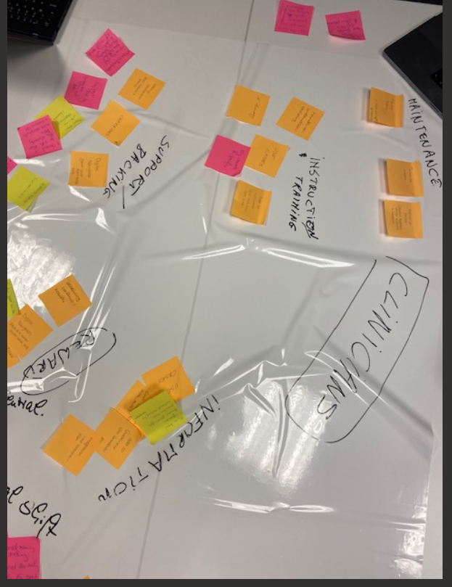
What did we do?
Identify relevant stakeholders
Identify specific and universal barriers and facilitators for the different stakeholders
Management
Clinicians
Clients
Reflecting on prior experience, blue-sky thinking, the literature.

Slide 4
Output
01
Documentation of strategies and challenger per stakeholder
02
Paper plan
03
Guidelines
04
ESM Network Meeting 2026: paper in a day
Notes:
Create google document to collect the topics per stakeholder group
Identify working groups
Different team meetings to discuss topics for the different stakeholder groups → we need more time to think about it!

Slide 5
Hackathon 2025
THANK YOU
esm-network.eu

