Slide 1



Paper in a Day 2025
EXTENDING THE CLINICAL TOOLBOX
DEEPENING THE USAGE OF EMA IN MENTAL HEALTHCARE THROUGH NEW PARAMETERS
Organizers:
Rogier Kievit, Jessica Schaaf, Janna Vrijsen, Anika Poppe
Attendees:
Nessa Ikani, Jindra Bakker, Annelies Schipper, Barabara Montagne
esm-network.eu

Slide 2
Our plan
THE PAPER
Now: EMA/ESM data in clinical practice → visualization
Complex models = more insights beyond visual interpretation
Identify/present example parameters
Using this information as conversation starter not statistical truth
THE PLAN
Methodologists, (applied) researchers, statisticians and scientist-practitioners/clinicians using ESM/EMA in one room
Preparation for the meeting:
  Outline
  Decide on which parameters to present in paper
Short discussion and brain-storming
Start writing in sub-groups

Slide 3

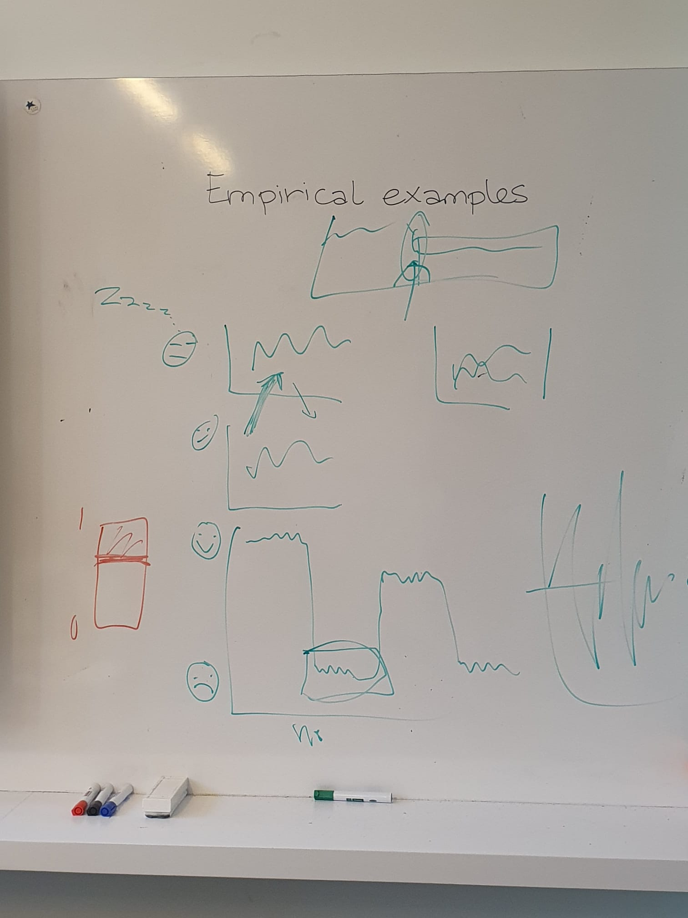
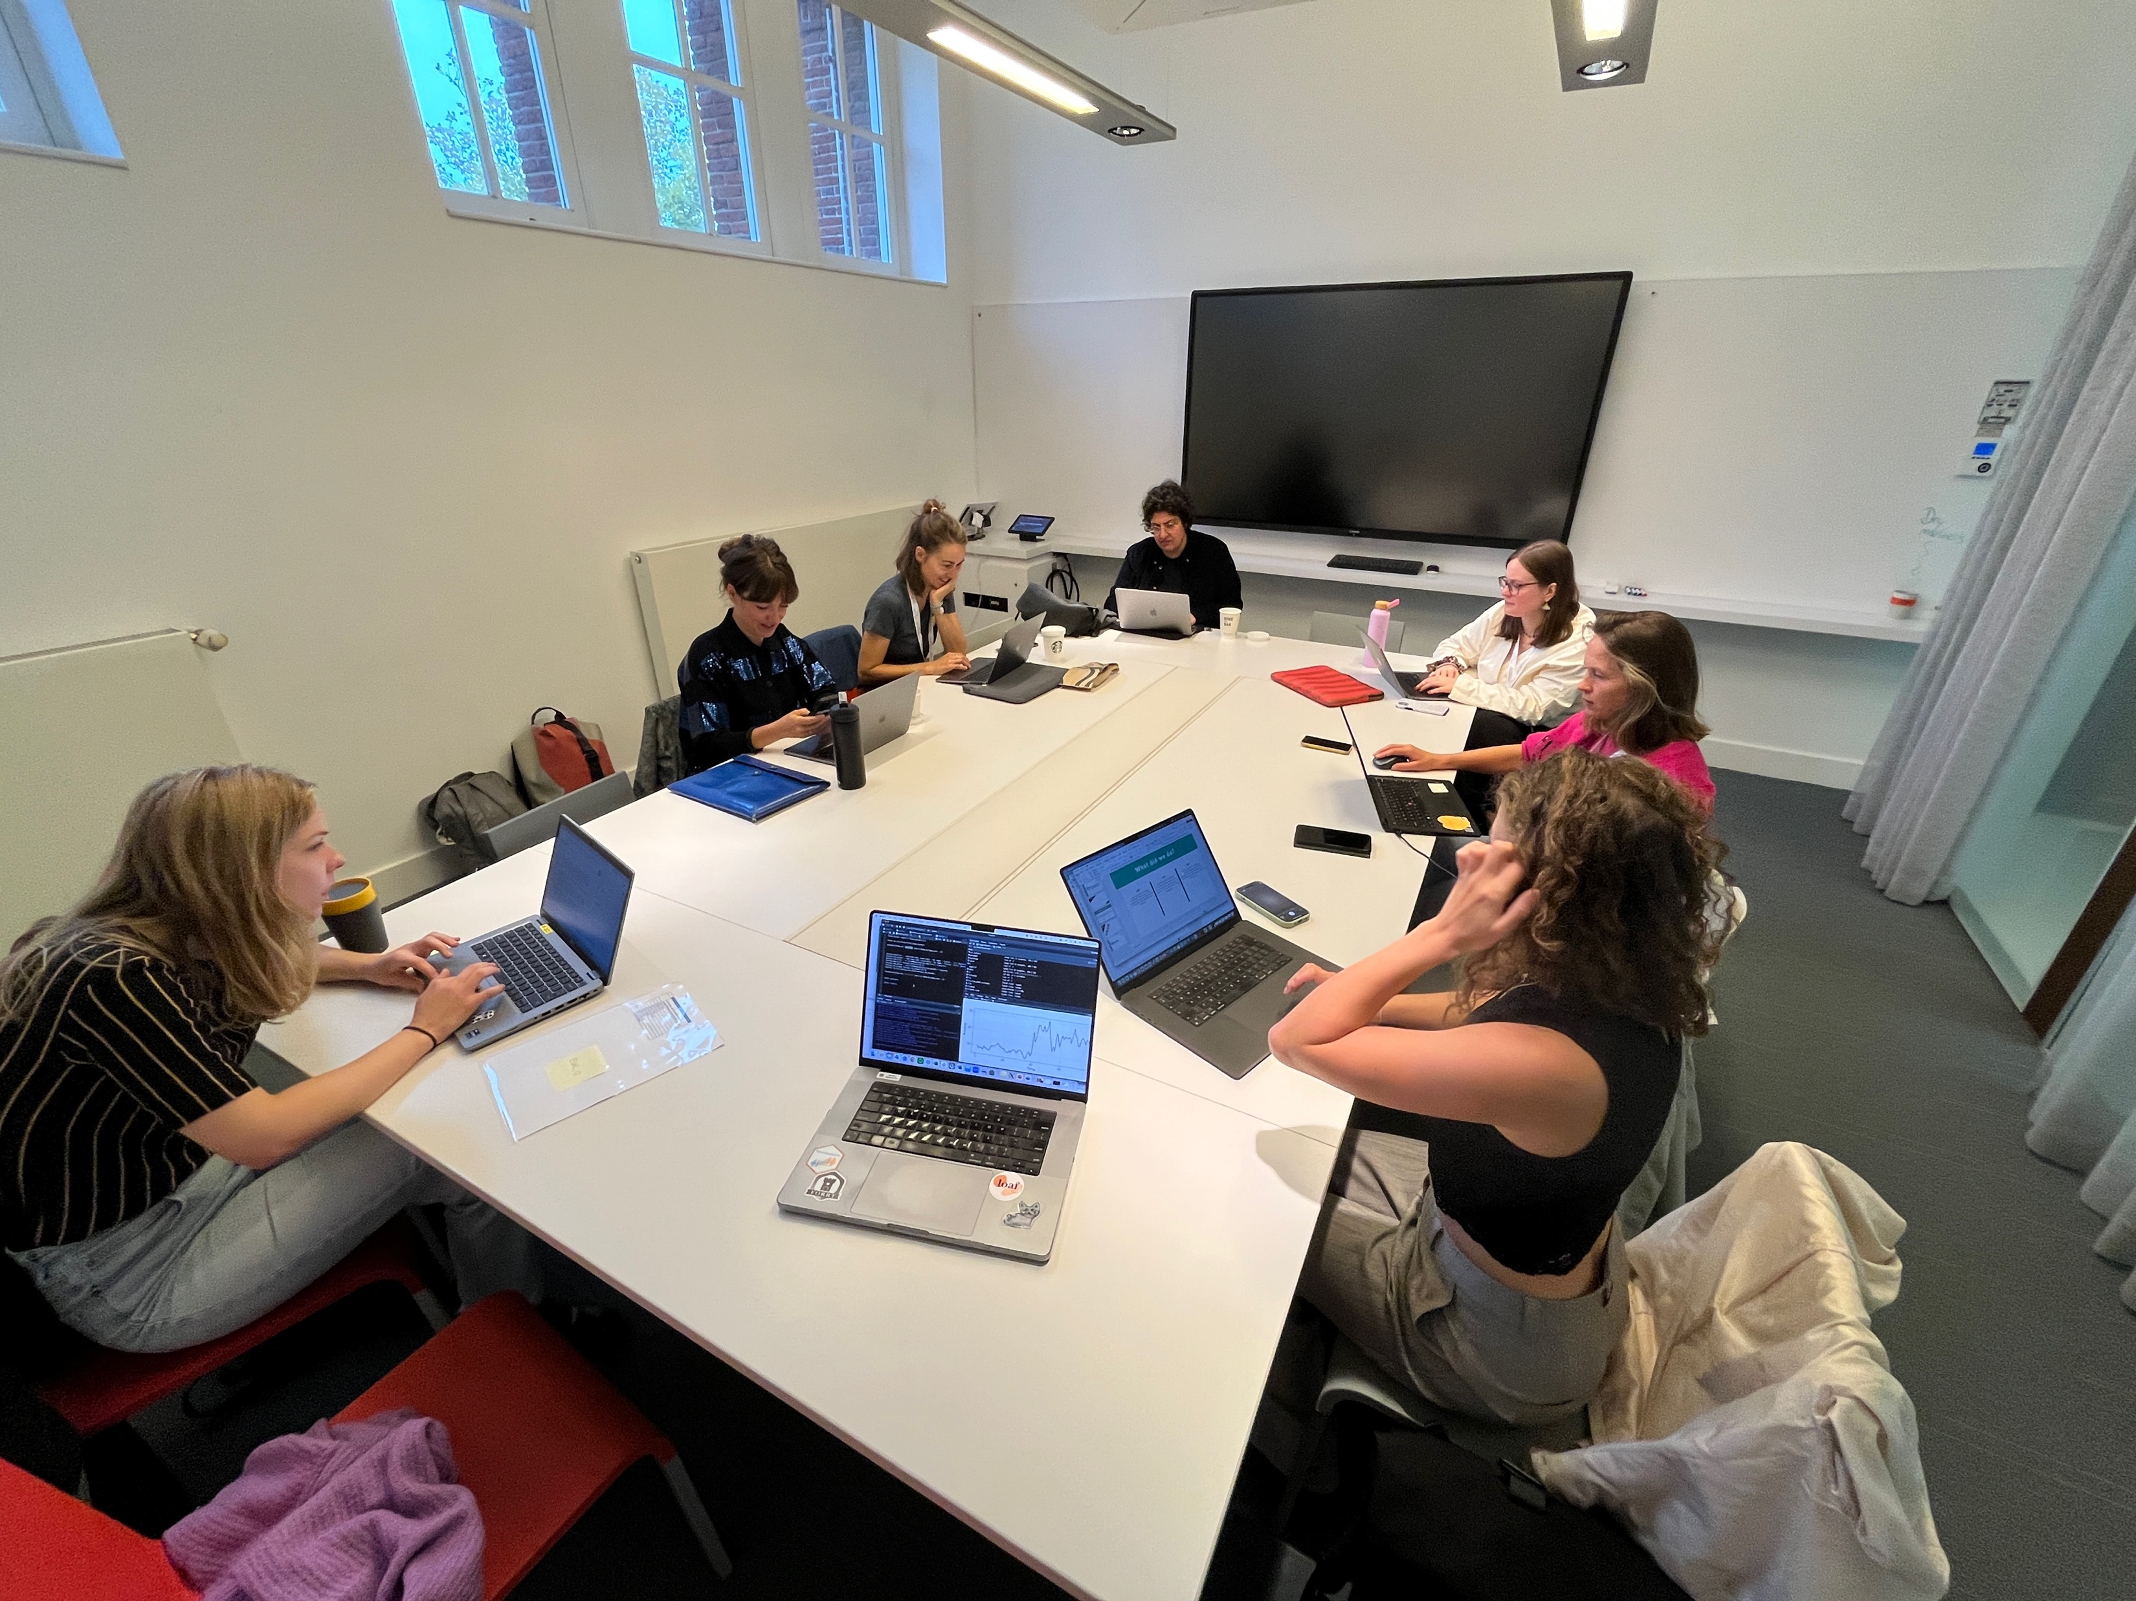
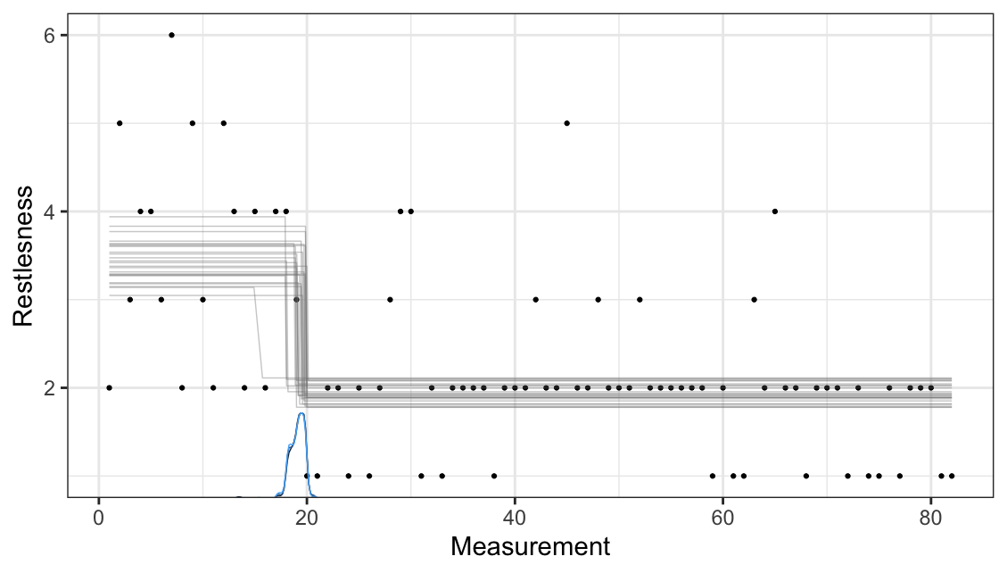
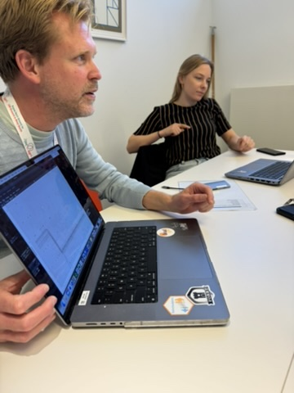
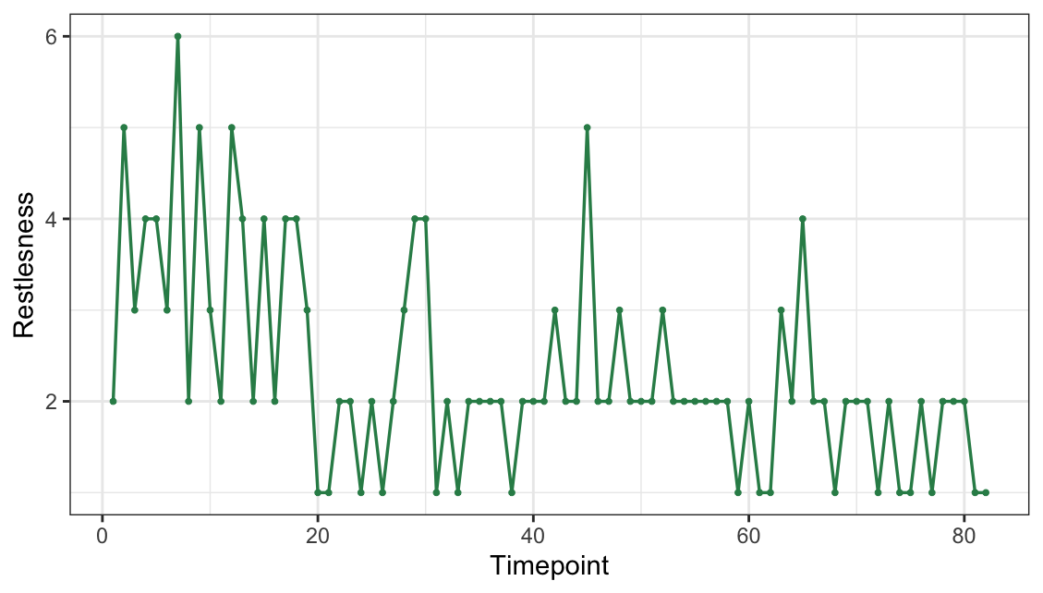
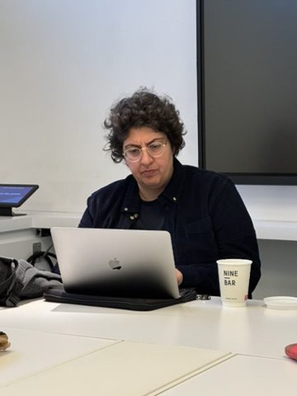
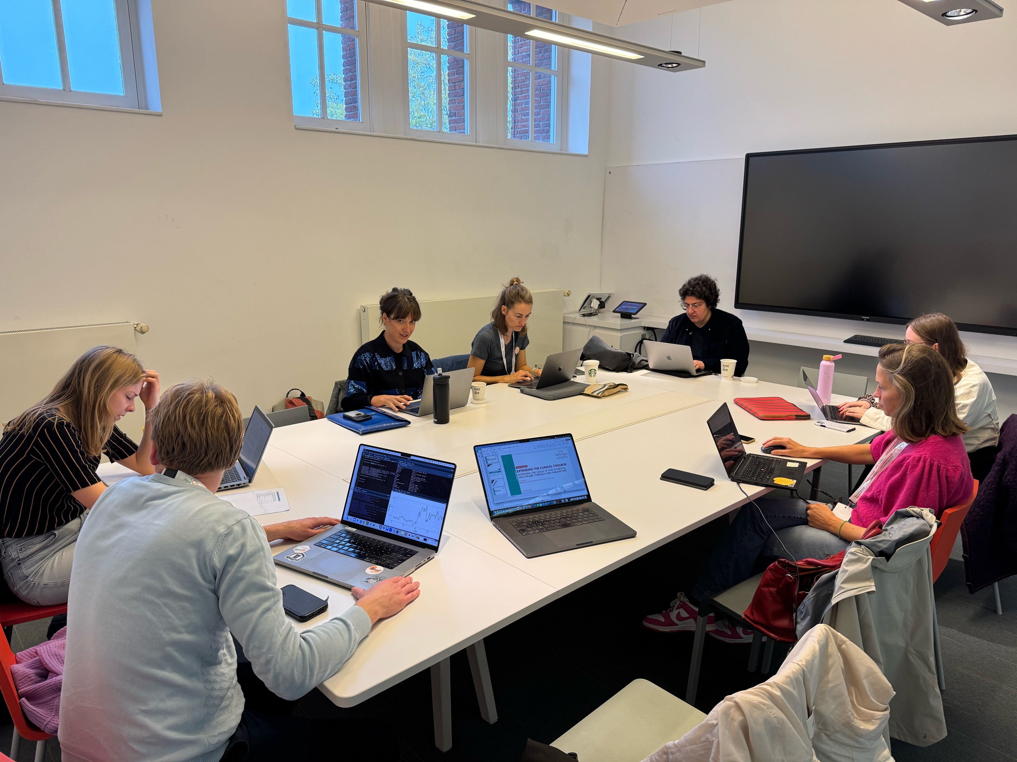
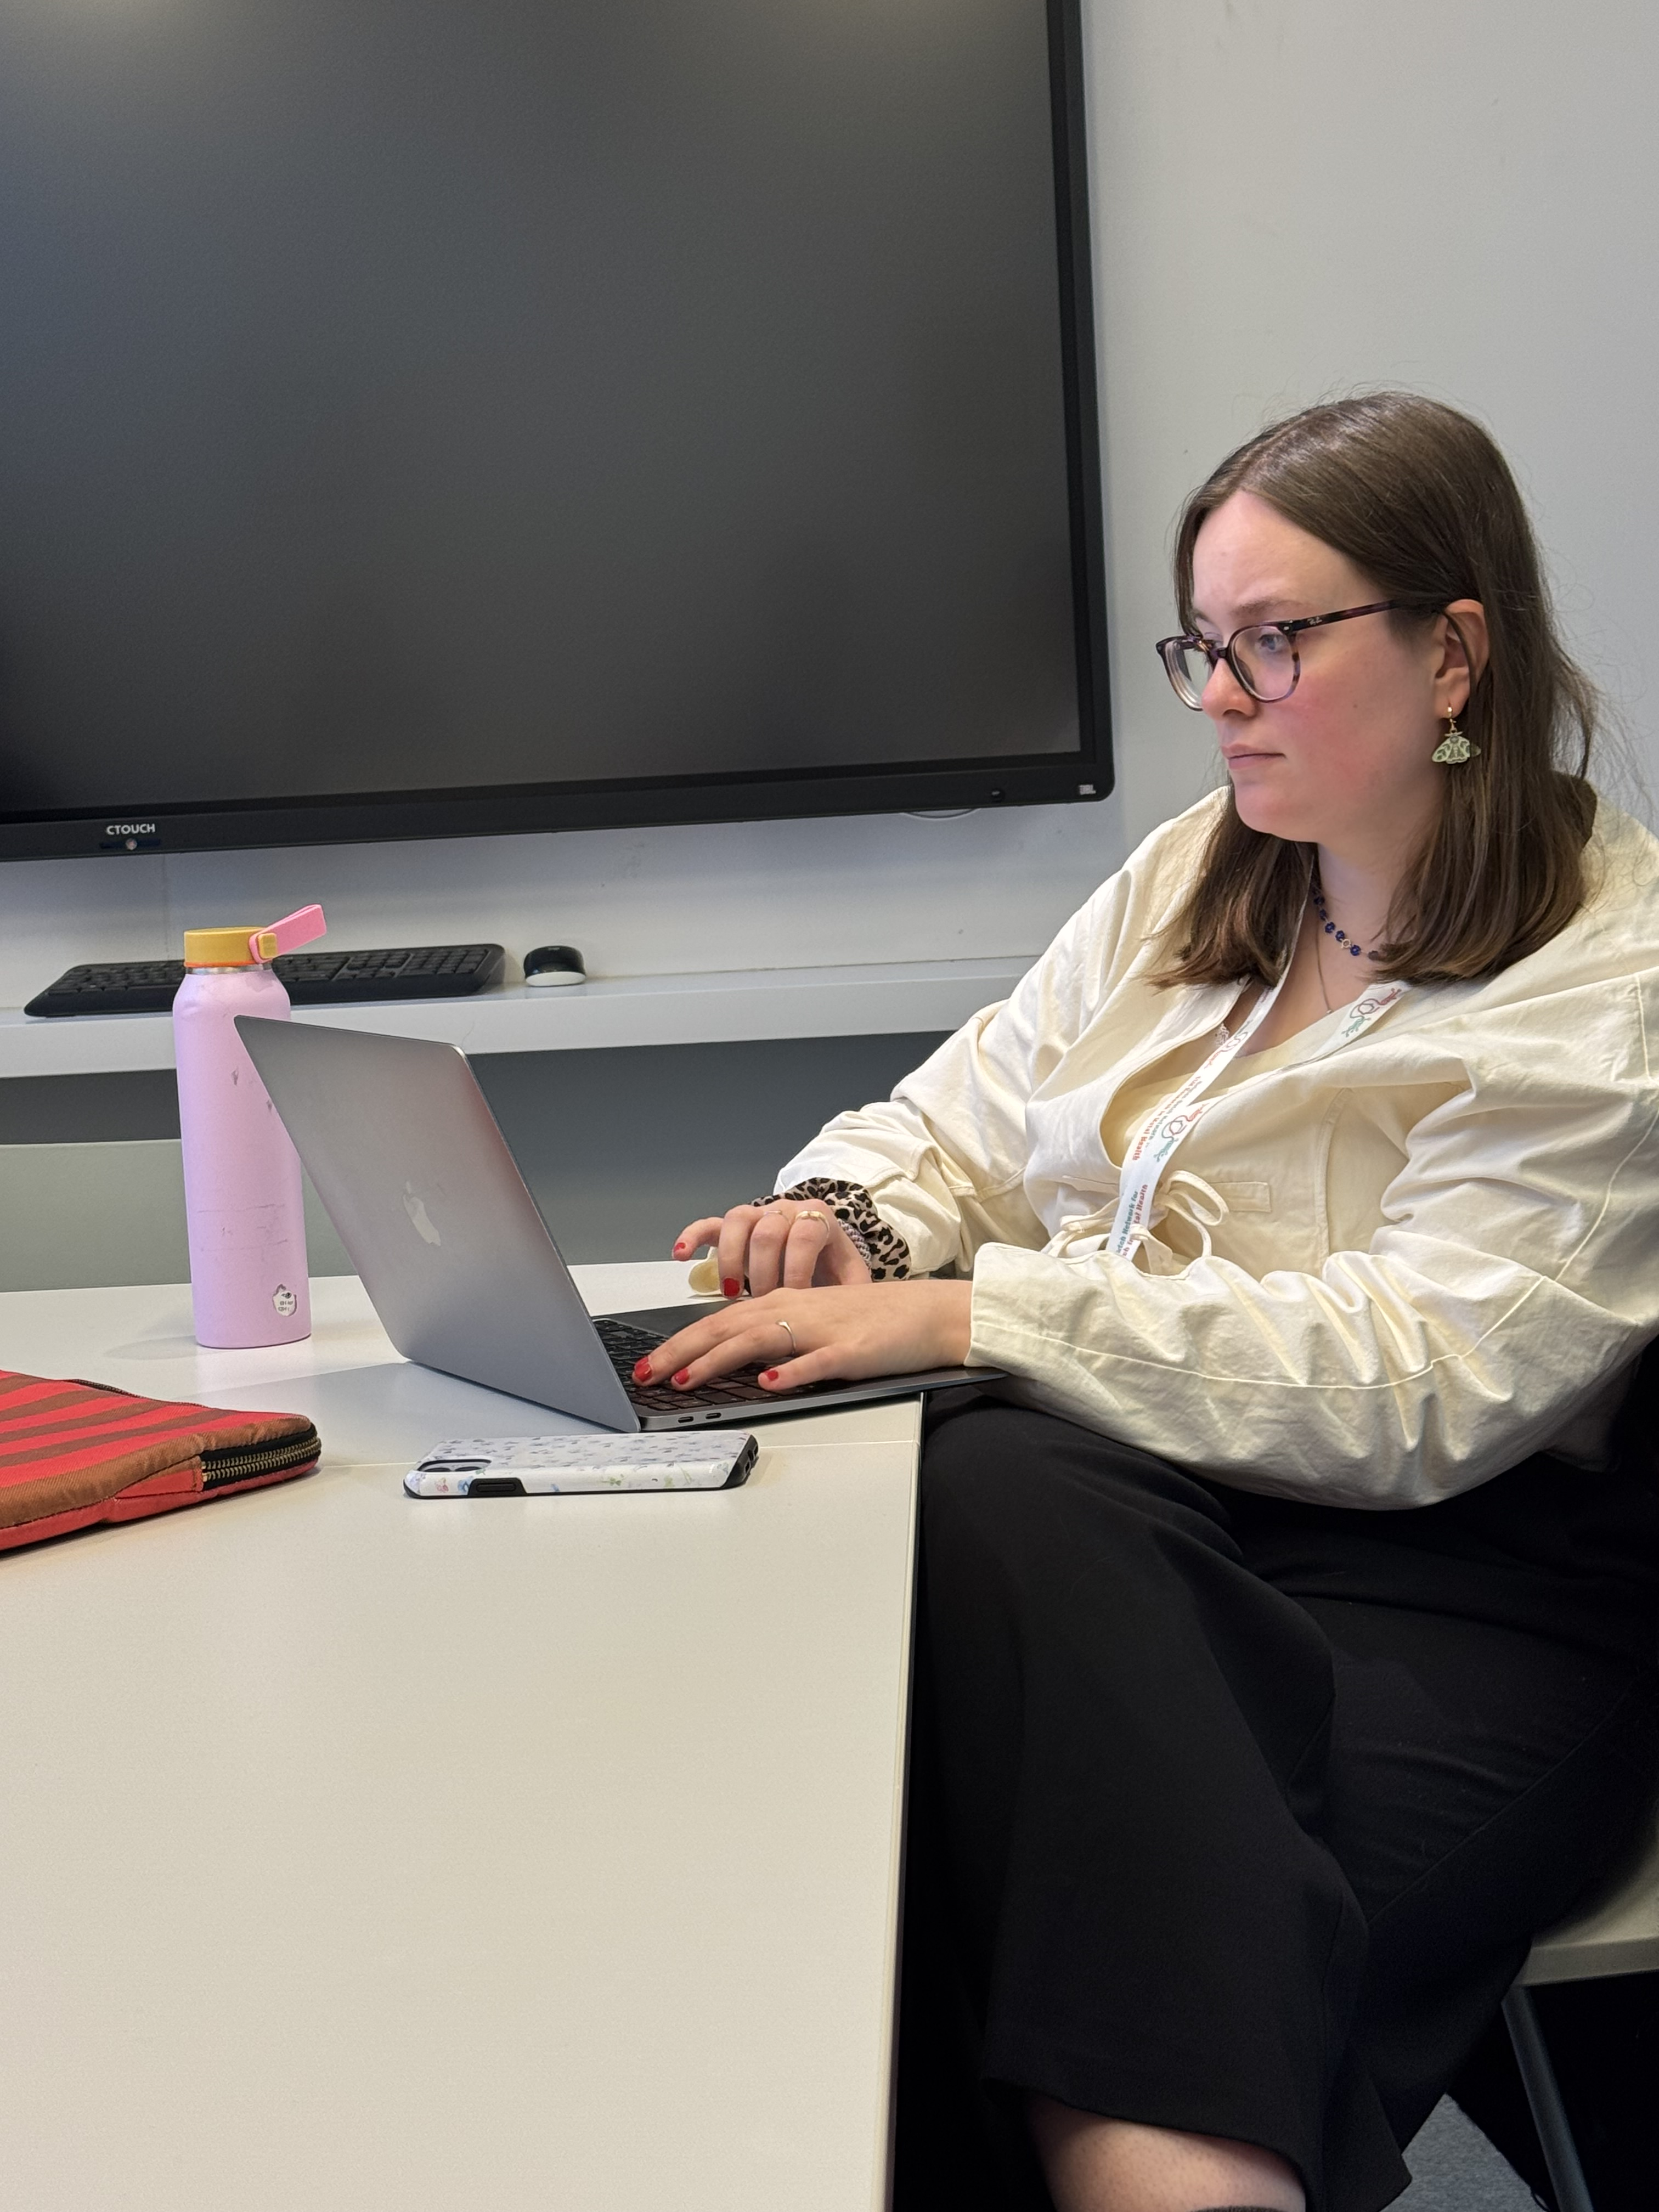
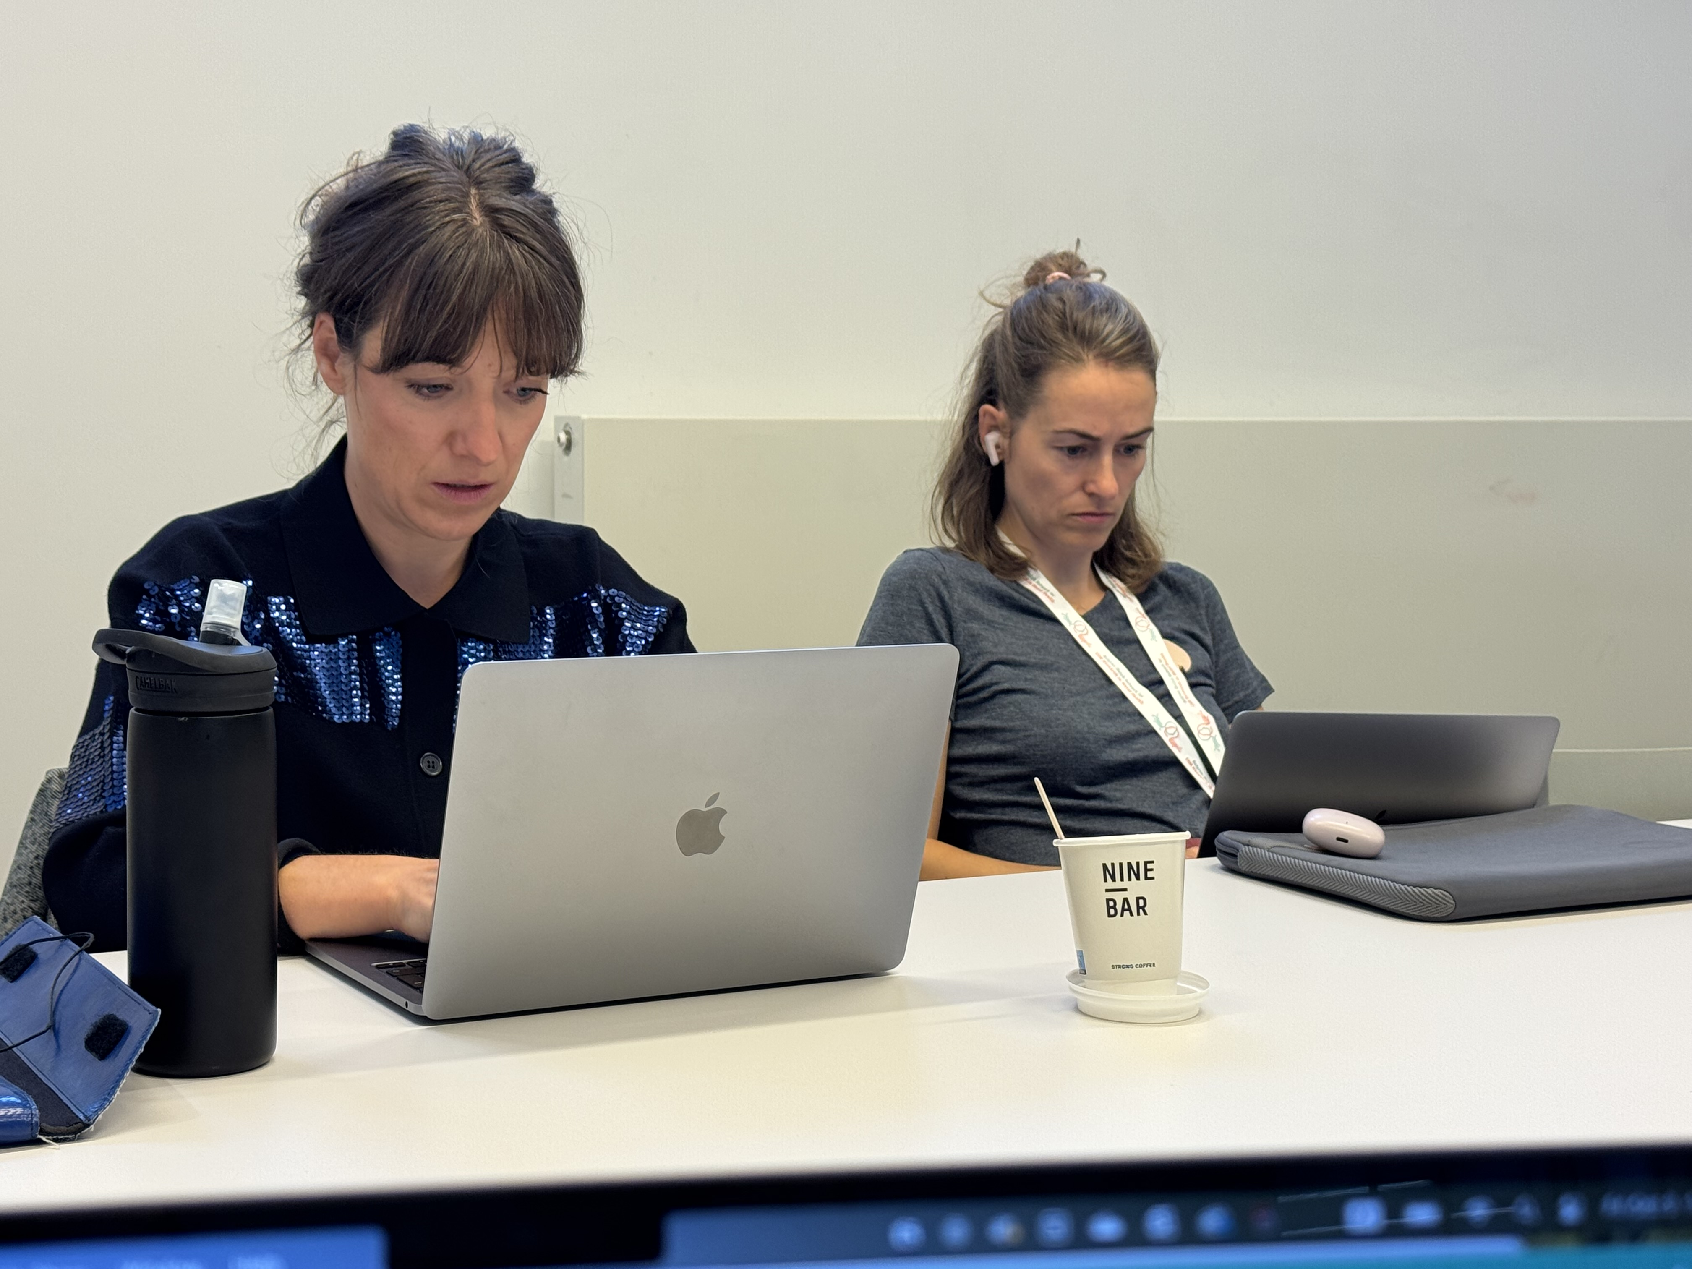
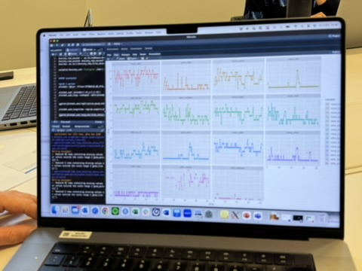
What did we do?
BRAINSTORM
WRITING
MODEL DATA
Current wordcount:
3627
Max wordcount target journal:
1500

Slide 4


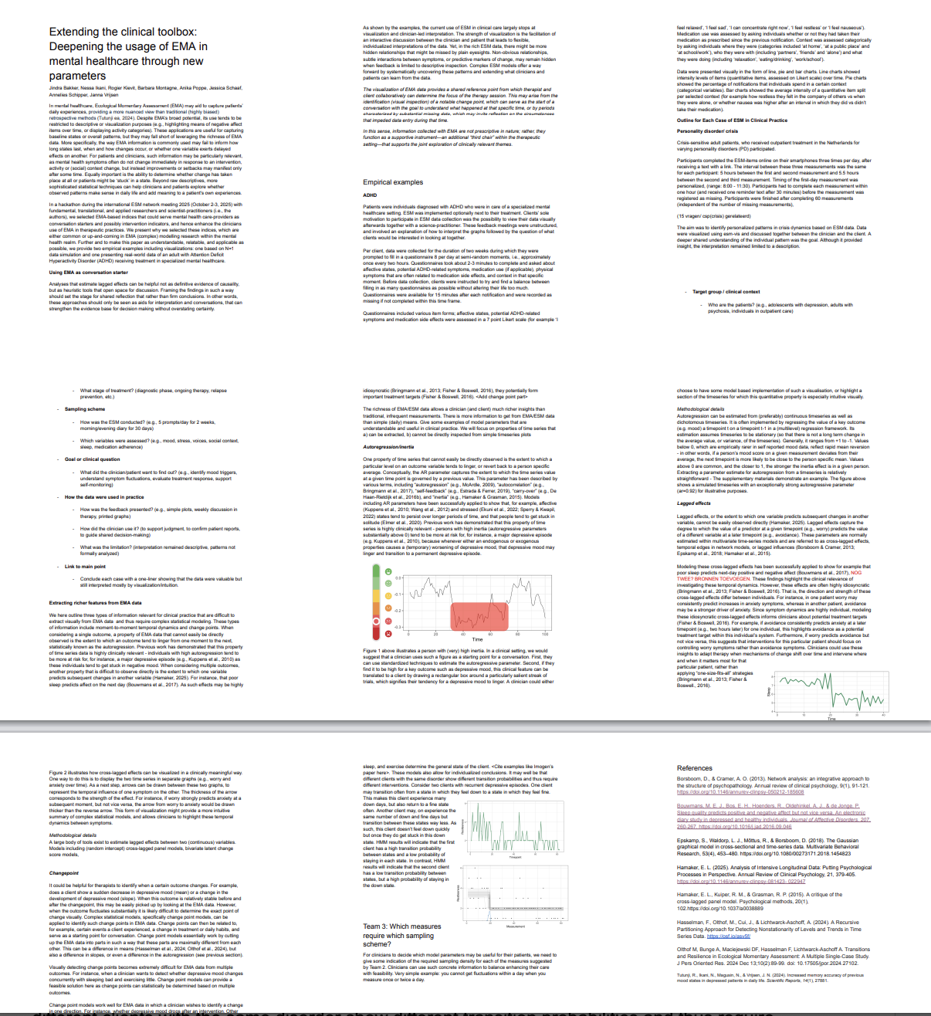



Next steps
  Finalize draft paper
Choose journal, continue writing
  Invite input from stakeholders
Therapists, clients/patients
Submit!
Accept as is, share & celebrate
Follow-up
Qualitative study

Slide 5
Paper in a Day 2025
THANK YOU
esm-network.eu

