Slide 1



ESM meeting 2025
Analyzing Skewed ESM Data
Anastasia Galkina^{1,2} & Wolfgang Viechtbauer¹
¹ Maastricht University, Department of Psychiatry and Neuropsychology
² University if Milano-Bicocca, Psychology Department
esm-network.eu

Slide 2



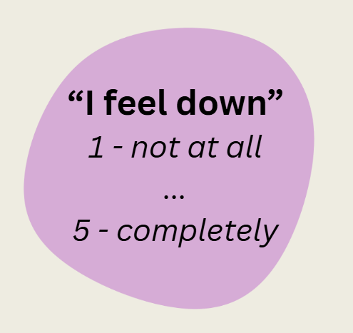
ESM Measurements
Paranoia
Negative Affect

Slide 3
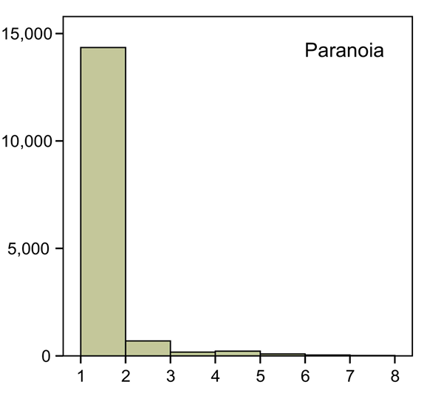
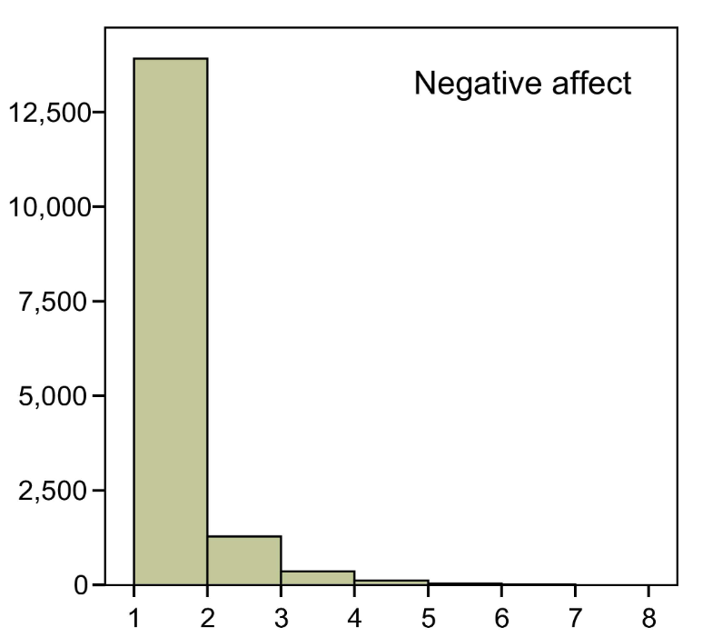
The Distributions are Right-Skewed
Terluin, B., De Boer, M. R., & De Vet, H. C. W. (2016). Differences in Connection Strength between Mental Symptoms Might Be Explained by Differences in Variance: Reanalysis of Network Data Did Not Confirm Staging. PLOS ONE, 11(11), e0155205. https://doi.org/10.1371/journal.pone.0155205

Slide 4
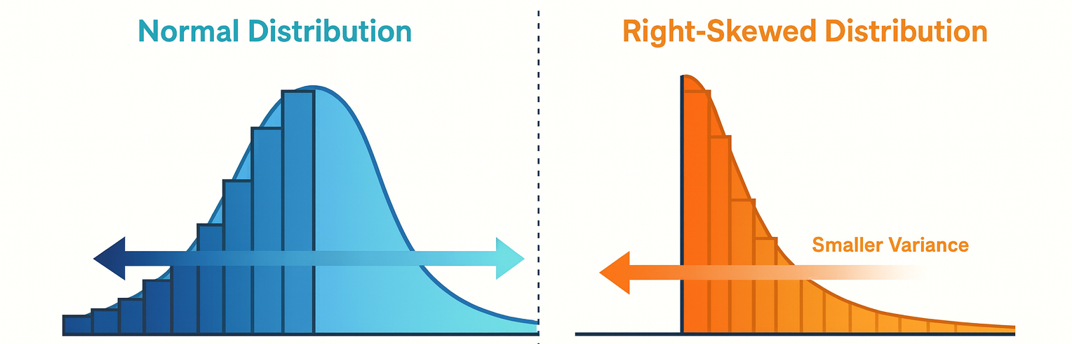
Artificial relationships between mean and variability for bounded scales

Slide 5



Censored manifestation
Event pleasantness
Day 1
Day 2
Latent continuum
Dejonckheere, E., Penne, I., Briels, L., & Mestdagh, M. (2024). For Better or for Worse? Visualizing Previous Intensity Levels Improves Emotion (Dynamic) Measurement in Experience Sampling. Psychological Assessment, 36(3), 215–234. https://doi.org/10.1037/pas0001296

Slide 6
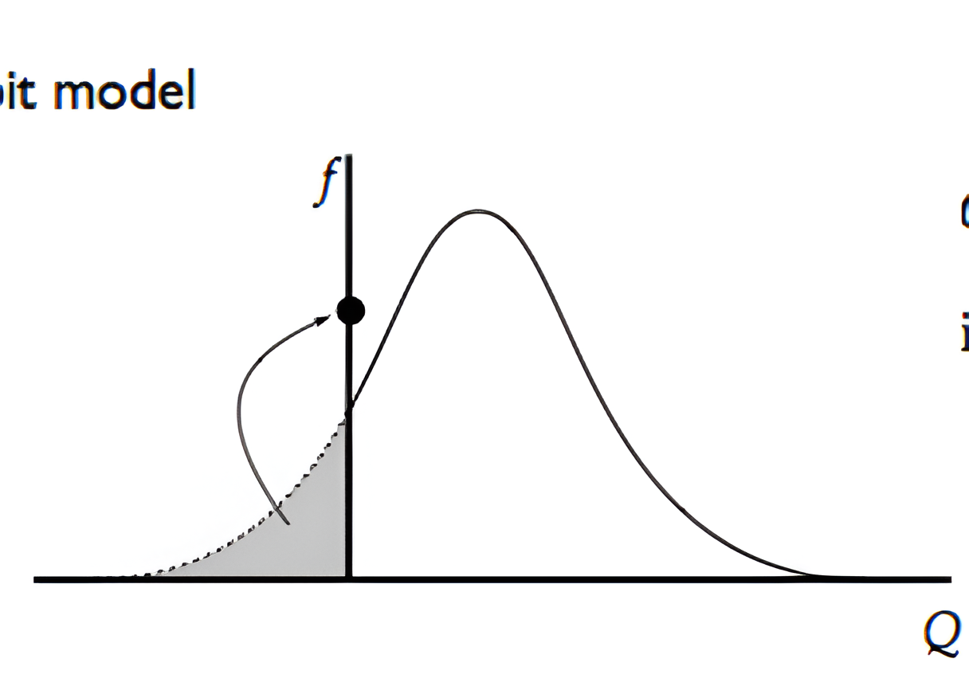
Tobit mixed-effects model
Censored manifestation
Latent continuum

Slide 7

Data: Positive and Negative Affect
PA – Progressive artificial censoring

Slide 8
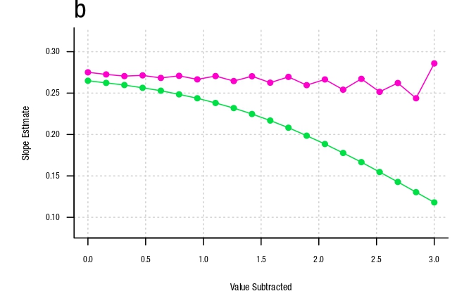
Slope Parameter Recovery
PA (censored) predicted by event pleasantness
for participants with depressive symptoms
Tobit model
Standard model

Slide 9
Slopes for Negative Affect

Slide 10
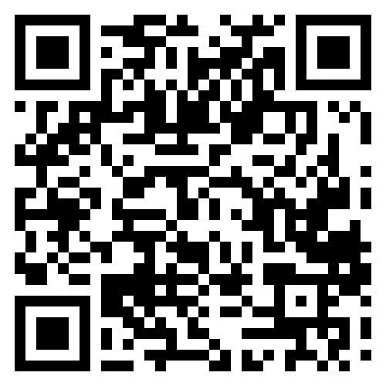
ESM meeting 2025
THANK YOU
Want to learn more?
Check our preprint:
esm-network.eu

