Slide 1
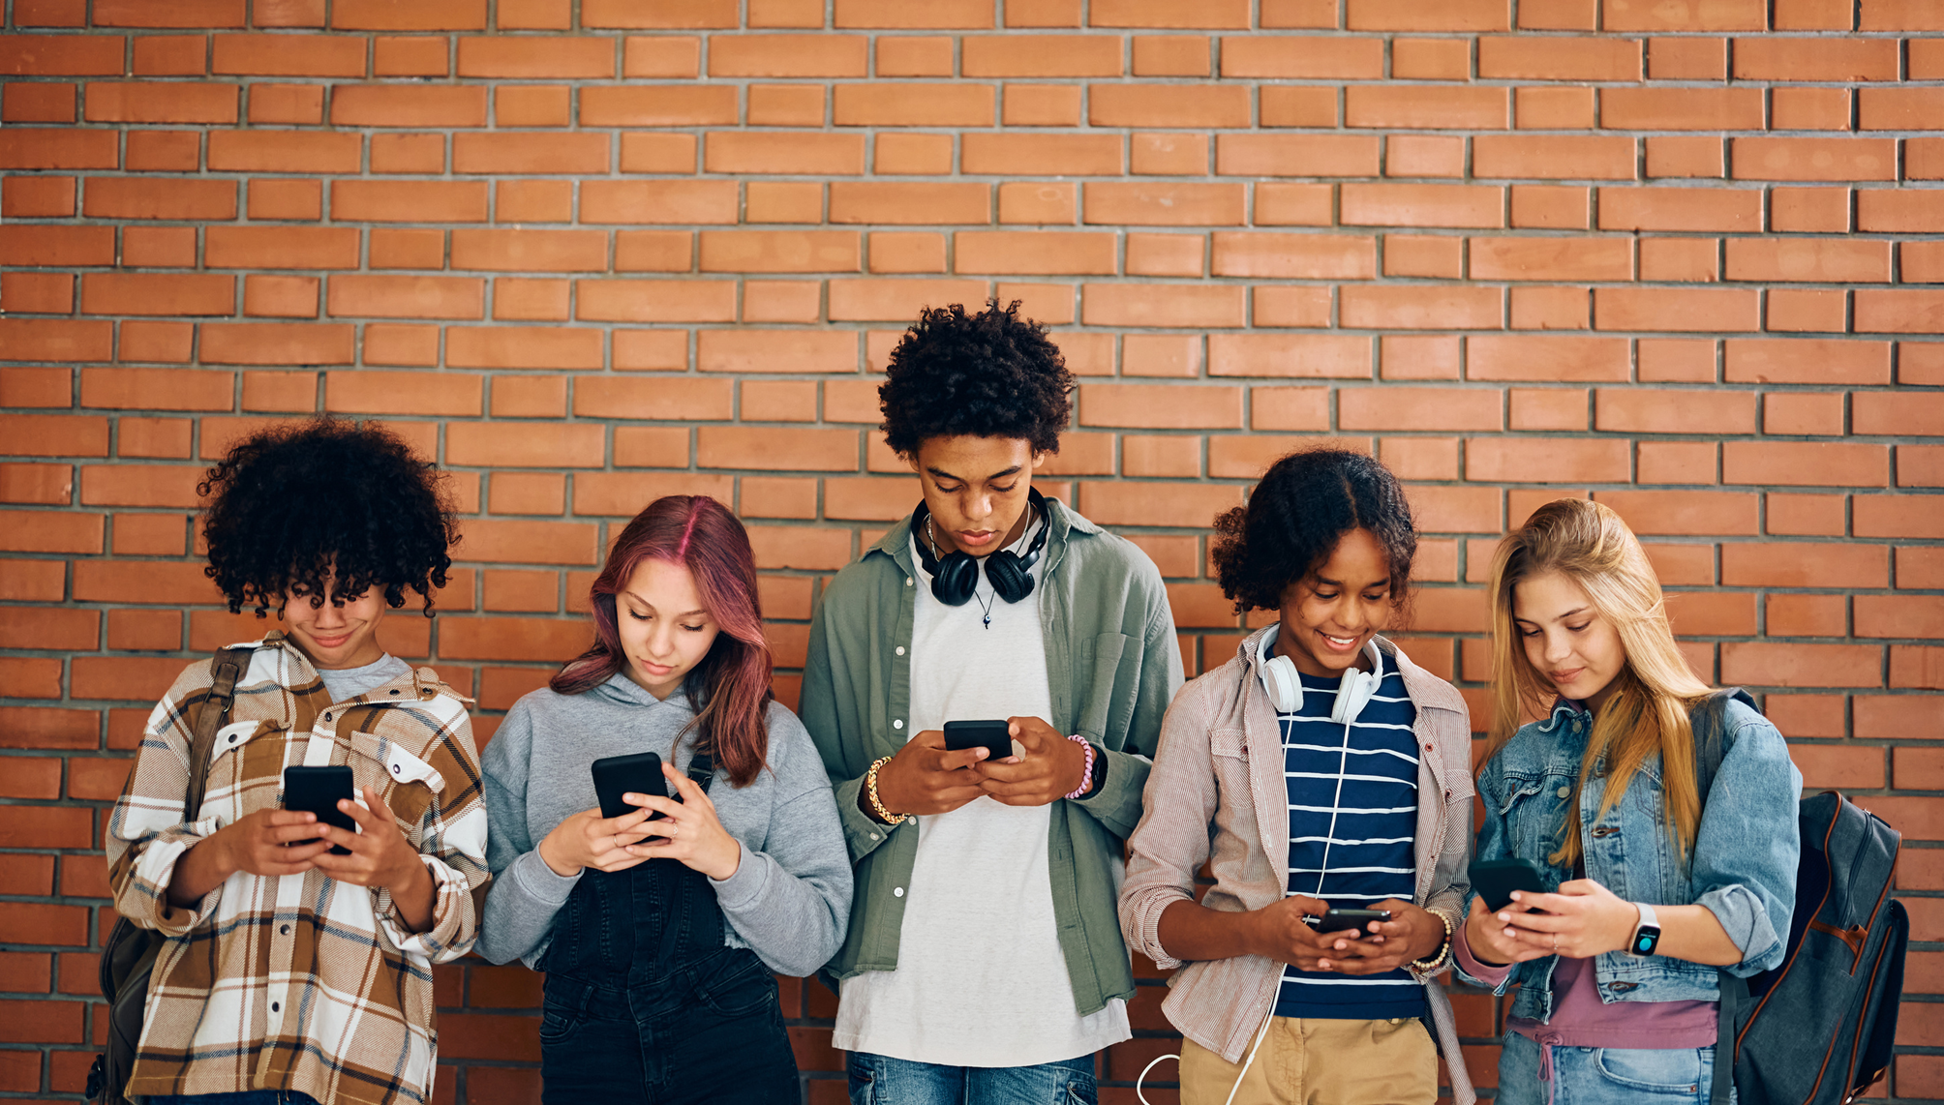




SPLASS STUDY
Smartphone Prohibition's Link to physical Activity, Sleep and Student's mental well-being in secondary education
dr. L. Huiberts
prof. dr. R. de Groot
Presented by Lieke Hartenberg- de Vries, PhD student

Slide 2

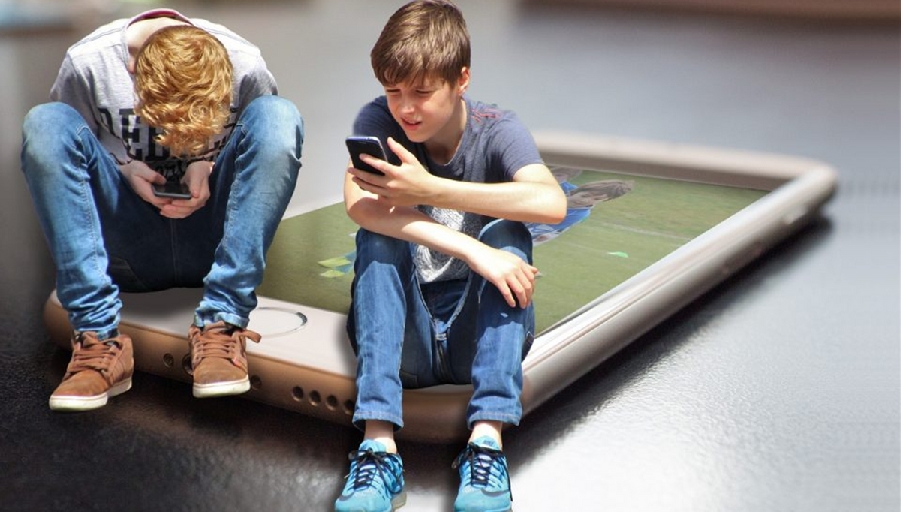


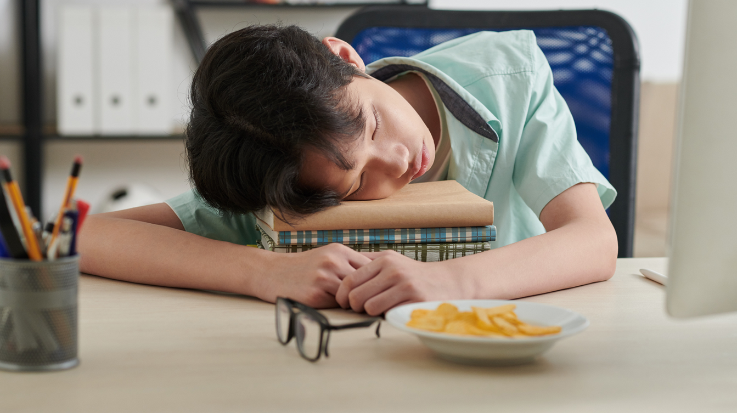
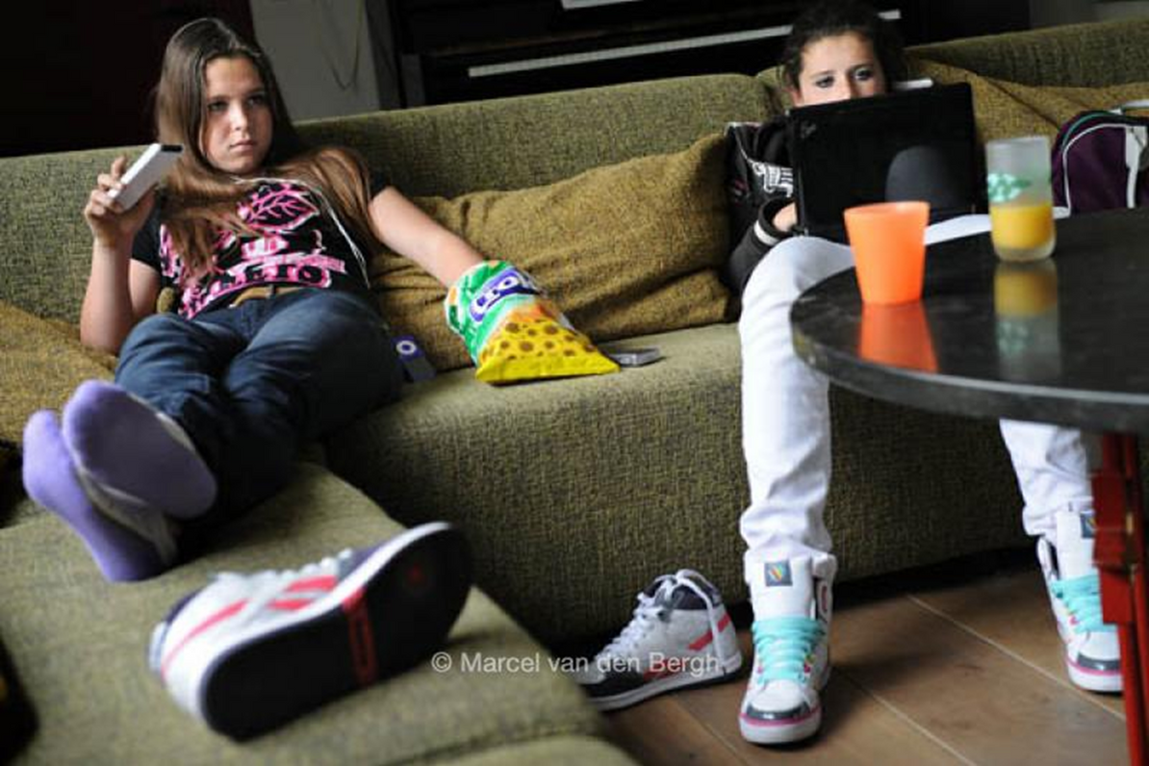
Notes:
- 1 in 3 students report low emotional well-being
• Smartphone use (5–6 hrs/day, avg.)
• Only 39% meet physical activity guidelines
• 25% report sleep issues
• Jan 2024: national classroom smartphone ban

Slide 3




9-day ESM study design
N=168
Smartphone use + Physical activity
Baseline measures
School hours
Sleep diary + School hours
1x SWEMWBS
5x SWEMWBS
Kraiss, J. T., Kohlhoff, M., & ten Klooster, P. M. (2023). Disentangling between- and within-person associations of psychological distress and mental well-being: An experience sampling study examining the dual continua model of mental health among university students.
Notes:
Baseline measures are:
- Demographics
_ Lifestyle: smoking, vaping, use of cannabis, alcohol use
- Smartphone use restrictions, like timers or apps. OS
Well-being: depressive symptoms: CESDR10. depressive symptoms
- WEMWBS : mental well-being
- PSQI: Pittsburg Sleep Quality Index
- MCTQ: Short version of the Munich Chronotype questionnaire.

Slide 4
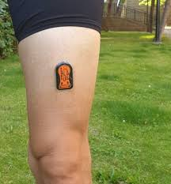
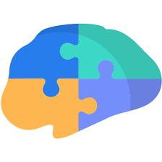
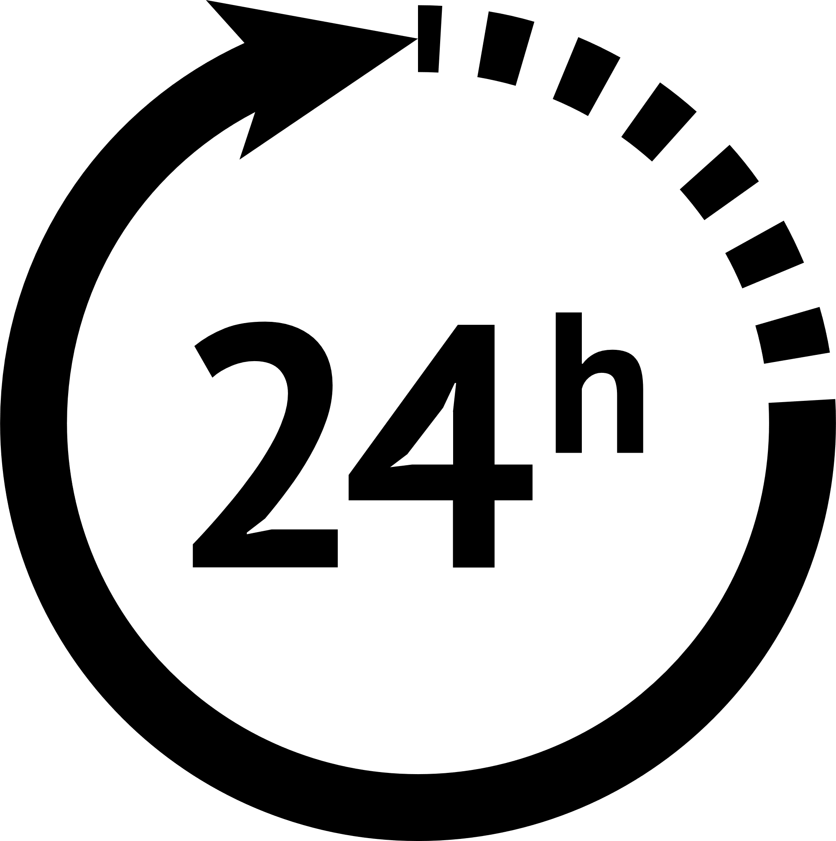







DATA COLLECTION
March 12 2025
March 21 2025
N = 51
March 31 2025
April 9 2025
N = 36
April 8 2025
April 18 2025
N = 46
May 12 2025
May 23 2025
N = 35

Slide 5
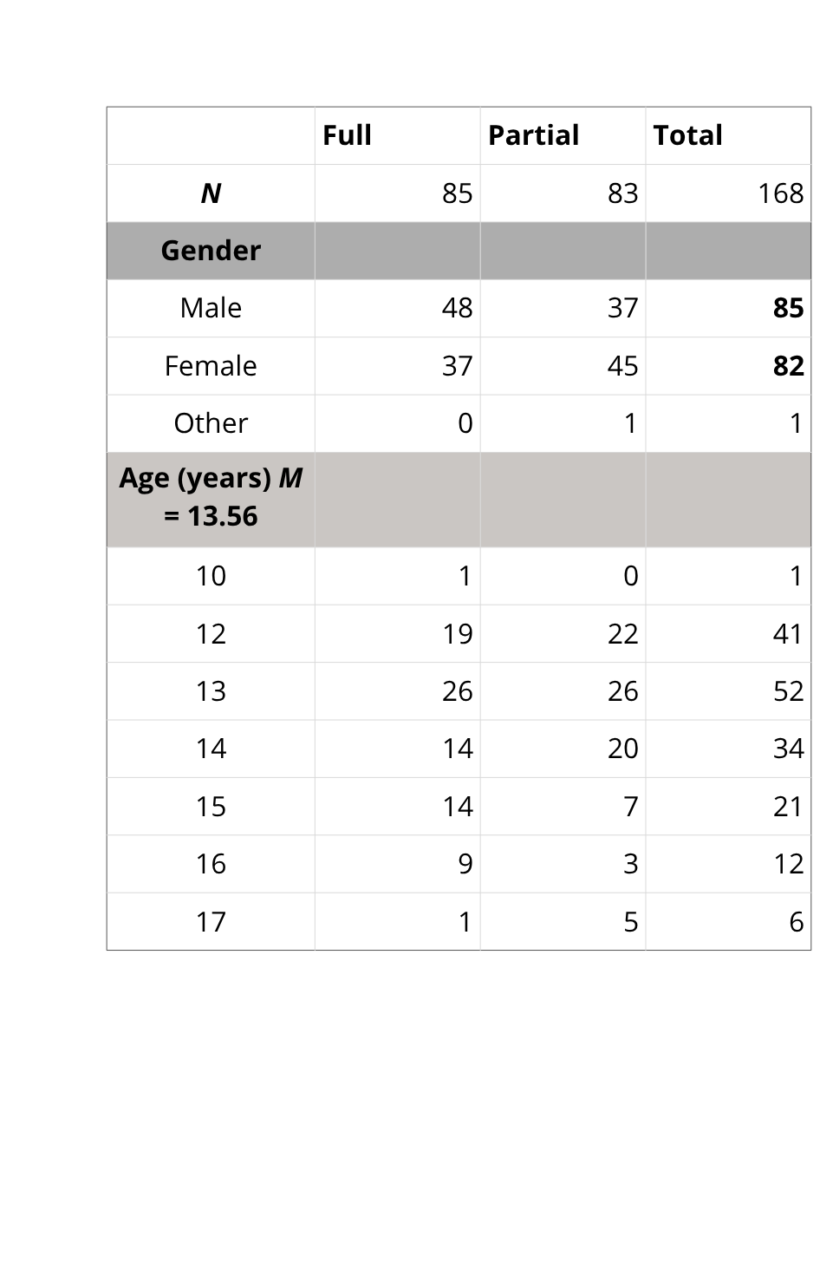
PARTICIPANTS
Dutch secondary school students from 6 schools (2 partial, 4 full)
All grades except exam years

Slide 6
Educational Tracks | Full | Partial | Total
Pre-university education (VWO) | 18 | 23 | 41
Combined general/pre-university track (HAVO/VWO) | 11 | 13 | 24
Senior general secondary education (HAVO) | 14 | 12 | 26
Mixed theoretical/general track (TL/HAVO) – combined class | 21 | 23 | 44
Pre-vocational: theoretical track (VMBO-TL) | 6 | 4 | 10
Pre-vocational: theoretical and mixed track (VMBO-GL/TL) | 6 | 0 | 6
Mixed vocational-theoretical track (Kader/GL) – combined class | 8 | 8 | 16
School Years | Full | Partial | Total
Year 1 | 40 | 40 | 80
Year 2 | 15 | 18 | 33
Year 3 | 11 | 16 | 27
Year 4 | 18 | 5 | 23
Year 5 | 0 | 4 | 4

Slide 7
PRELIMINARY RESULTS
Smartphone Use

Slide 8
PRELIMINARY RESULTS –
Well-being

Slide 9
PRELIMINARY RESULTS
well-being

Slide 10

NEXT STEPS
Further analysis of daily fluctuations
Follow-up qualitative study

Slide 11
Further reading
Adolescent smartphone use, sleep, and physical activity: Daily associations between sensor-based measures in the adolescent brain cognitive development (ABCD) study. Psychiatry Research, 349, 116523. https://doi.org/https://doi.org/10.1016/j.psychres.2025.116523
Brummer, E. C., & Achterberg, M. (2025). Dwang versus Draagvlak: Jongeren over het smartphonebeleid op middelbare scholen. https://doi.org/https://doi.org/10.17605/OSF.IO/T5GMH
Goodyear, V. A., Randhawa, A., Adab, P., Al-Janabi, H., Fenton, S., Jones, K., Michail, M., Morrison, B., Patterson, P., Quinlan, J., Sitch, A., Twardochleb, R., Wade, M., & Pallan, M. (2025). School phone policies and their association with mental wellbeing, phone use, and social media use (SMART Schools): A cross-sectional observational study. The Lancet Regional Health – Europe, 51. https://doi.org/10.1016/j.lanepe.2025.101211
Randhawa, A., Pallan, M., Twardochleb, R., Adab, P., Al-Janabi, H., Fenton, S., Jones, K., Michail, M., Patterson, P., Sitch, A., Wade, M., & Goodyear, V. A. (2024). Secondary school smartphone policies in England: A descriptive analysis of how schools rationalize, design, and implement restrictive and permissive phone policies. Journal of Research on Technology in Education, 1-20. https://doi.org/10.1080/15391523.2024.2363204

Slide 12
Thank You
For your attention
lieke.hartenberg-devries@ou.nl

