Slide 1
Predicting Dropout in Intensive Longitudinal Data
Extending the Joint Model for Autocorrelated Data Fridtjof Petersen, Laura F. Bringmann, Dimitris Rizopoulos

Slide 2
What are joint models?
Longitudinal: Multiple observations per person over time (e.g. ESM data)
Time-to-event: Binary events with a time-stamp (e.g. therapy dropout)
1. Describe how ESM data changes over time for an individual
2. Use change to predict when events are likely to happen

Slide 3
Why are they important?
Timing of events is often ignored in outcome predictions
JMs allow us to predict if and when an event is likely to occur
ESM and event outcomes do not match in terms of timescale
JMs make dynamic predictions for new participants as we collect new data

Slide 4
Our study
We extended joint model to handle autocorrelation of ESM data
We predicted dropout from an ESM study using affect and intermittent missingness
Better predictions than baseline variables? (age, sex, depression)

Slide 5
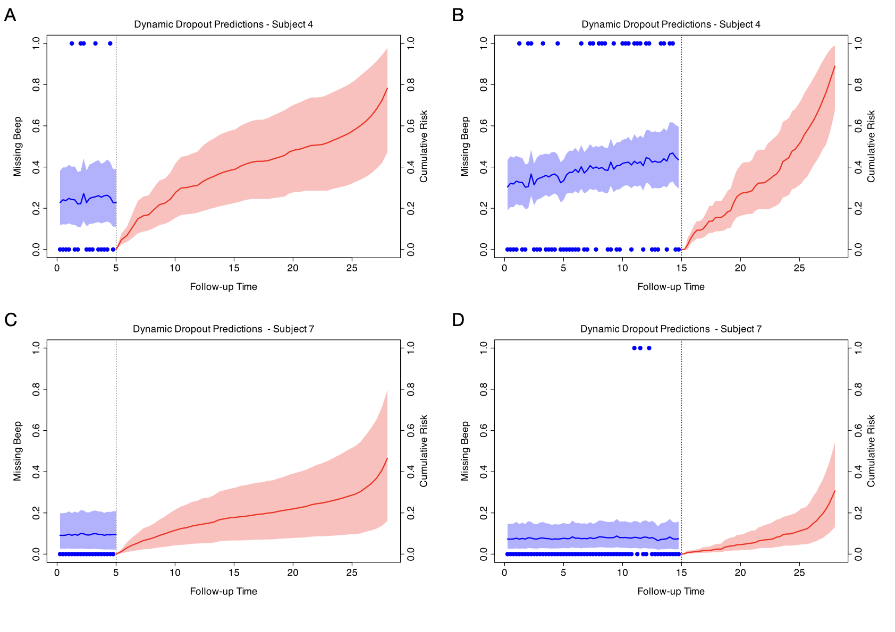

Slide 9


Summary
Joint models allow us to integrate both longitudinal and time-to-event data in a single model
Provides updated, individualised risk estimates that could inform interventions
Questions?
Paper ->
@fridtjofptrsn.bsky.social

