Slide 1




Hackathon 2025
Co-Creating EMA: Challenges and Design Solutions for Person-Centered Assessment
Ilse van de Groep, Reshmi Marhe, Jennie Lukoff
esm-network.eu

Slide 2






Goals
Resource-intensive
Complicated standardization
How can participation be optimized given the available resources?
How to deal with flexibility vs. comparability?
Learn about co-creation
methods on a meta-level by experiencing them

Slide 3


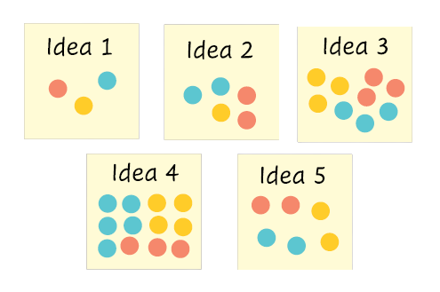
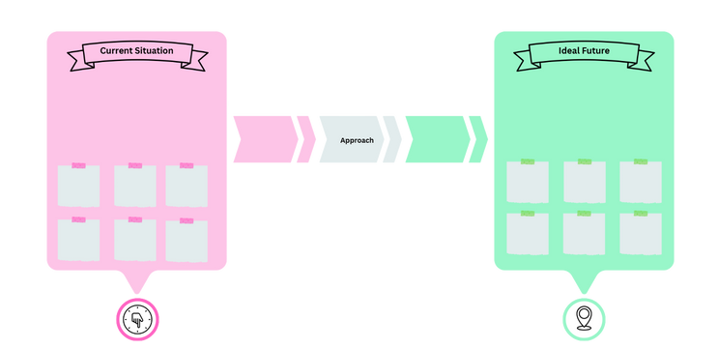
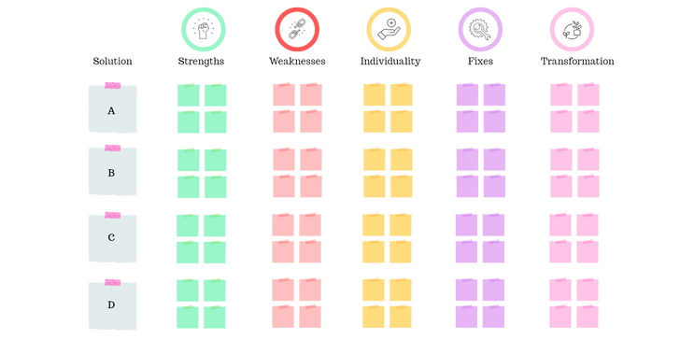
What did we do?
Future back-casting
SWIFT Analysis
Shared decision-making
Explore the current situation, ideal situation, and ways to get there.
Explore strengths, weaknesses, individuality, fixes (to weaknesses) and transformation of potential solutions.
Use priority and dot-voting to co-determine which solutions are the most promising.

Slide 4



Output
WHY
APPROACH
WHO(M)
WHAT
HOW
WHEN
With / for whom?
Roles / power balances
What types of experiences do we need?
Items
Personalization
Reserach question
Online, async, etc.
Individual / group-based
In what stage of the process?
How often to get to saturation

Slide 5
Hackathon 2025
THANK YOU
esm-network.eu

