Slide 1



ESM meeting 2025
What ESM Items Matter?
Adolescent-Based Validation Through a Thinking-Aloud Task
Jennifer Chen, Dr. Melissa de Smet and Dr. Bennett Kleinberg
Tilburg University

Slide 2

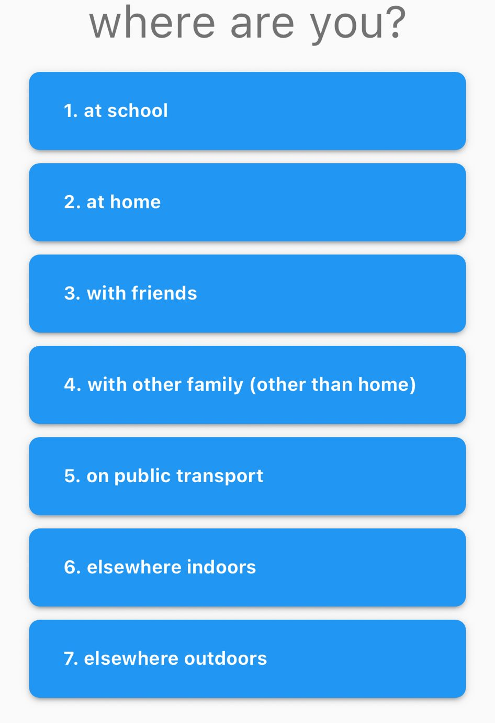
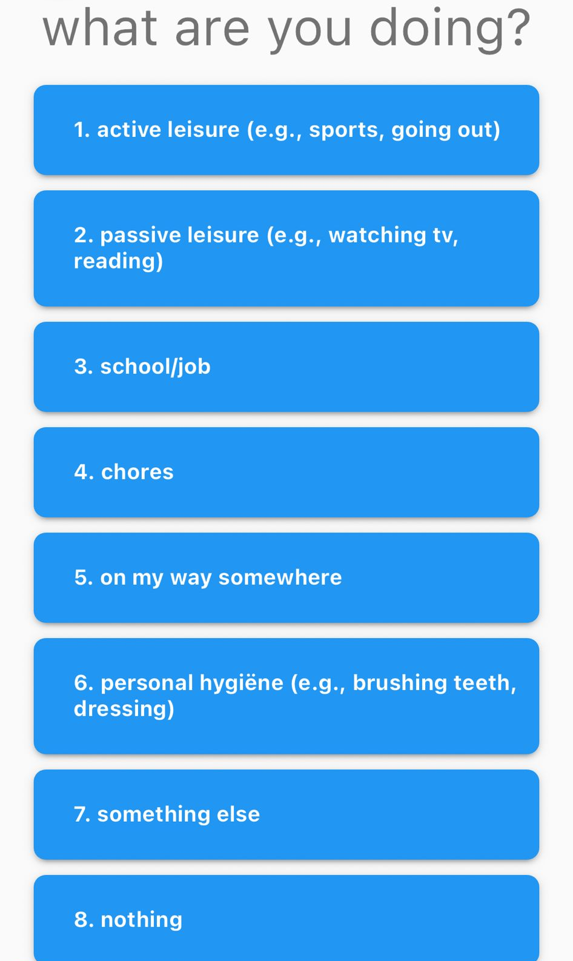
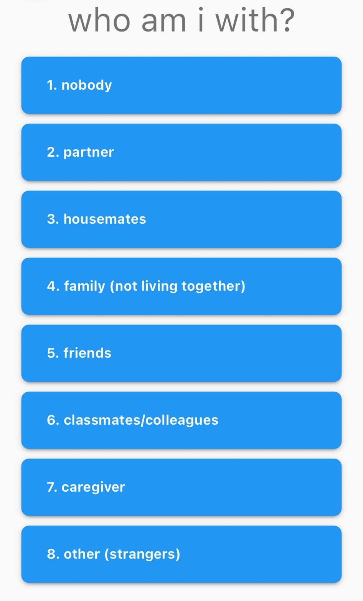
COMMON ESM ITEMS + ANSWERS

Slide 3
COMMON ESM ITEMS + ANSWERS
Adolescent-Based Validation
We need input from the adolescents themselves when choosing/designing ESM items
What items are meaningful?
What features are useful?
Questionnaire items vs. open-ended questions?

Slide 4



THINKING-ALOUD METHOD
ESM items
ESM item repository (Kirtley et al., 2020)
Items used in adolescent samples and/or used in the context of depression
Testing ESM features in m-Path
~130 items examined
Participants
21 students (Mage = 20.5, SD = 1.3)
In the past 2 years have attended some form of psychotherapy
Thinking-Aloud Task
Form of Cognitive Interviewing (Willis, 2005)
Reporting of all thoughts and thought processes related to a shown questionnaire item (Ericsson & Simon, 1980)
Kirtley, O. J., Hiekkaranta, A. P., Kunkels, Y. K., Eisele, G., Verhoeven, D., Van Nierop, M., & Myin-Germeys, I. (2020, October 1). The Experience Sampling Method (ESM) Item Repository. https://doi.org/10.17605/OSF.IO/KG376
Willis, G. B. (2005). Cognitive interviewing. SAGE Publications, Inc., https://doi.org/10.4135/9781412983655
Ericsson, K. A., & Simon, H. A. (1980). Verbal reports as data. Psychological Review, 87(3), 215-251. https://doi.org/10.1037/0033-295X.87.3.215

Slide 5
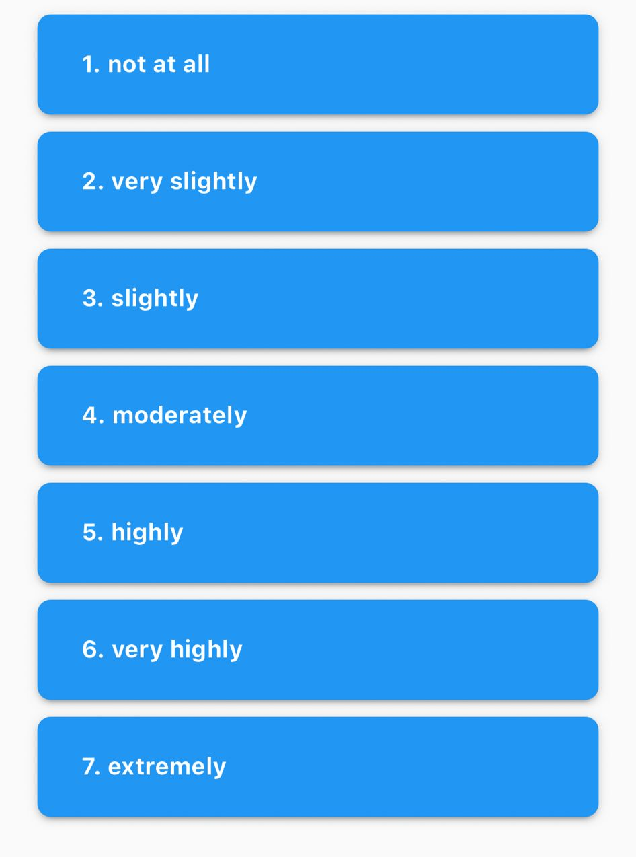
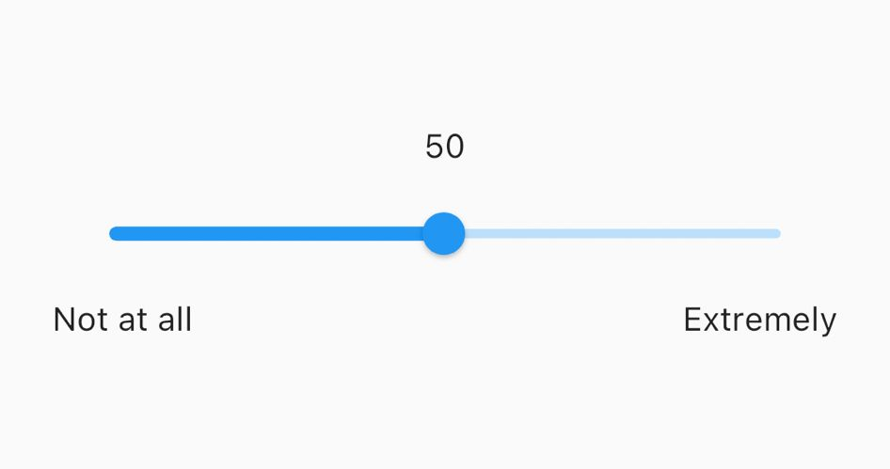


THINKING-ALOUD METHOD
“Would be nice if you could type in your own answer.”
“What do you mean by nothing?”

Slide 6
THINKING-ALOUD METHOD
Qualitative Content Analysis
21 interview transcripts
Interpretation of the content – frequencies, patterns
Based on your experiences, what are things I should focus on in the analysis?

Slide 7
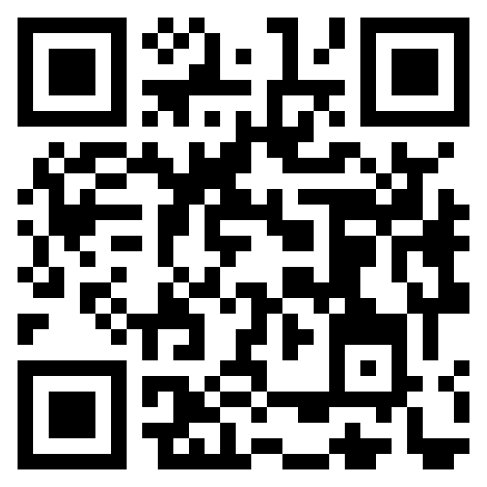
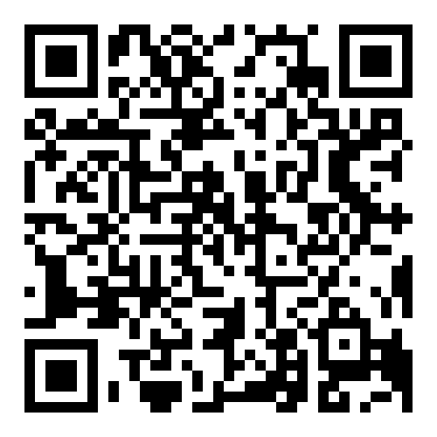
ESM meeting 2025
THANK YOU
esm-network.eu
LinkedIn
OSF project page

