Slide 1
Towards a better understanding of the (unequal) influence of parenting: It’s about time!

Slide 2
Prof. dr. Renske Keizer
Shelby Sissing MSc
dr. Maaike Hornstra
Petra Olsthoorn MSc
Hoofdonderzoeker
Onderzoeker
Promovendus
Project- en datamanager

Slide 3
Research question / why
Background
Social inequality between children is growing
Class differences in the ability to use, control and negotiate time
Time as a resource that may affect parenting and drive inequalities
Stratified incidence and implications of unexpected events
Recognize the normal unpredictability of daily (family and work) life
Capture unequal consequences for parenting and wellbeing by class

Slide 4
Research question / why
This project
Collect ESM data on how people deal with unexpected events, among mothers and fathers from both higher and lower social class families
Embedded in ongoing survey on stratification processes within and across families in Rotterdam.
The collection of rich qualitative data to develop time-sensitive theory based on findings derived from the ESM data collection.

Slide 5
Our ESM study
100-day diary study
The target was 20,000 observations collected in 100 days among 200 parents. Linked to 3HOEK baseline questionnaires.
Research goal
Gaining insight into how unexpected events cause fluctuations in the parenting of mothers and fathers (within-person), and possible differences by social class (between-person).

Slide 6
Recruitment & Timetable
Recruitment
Have at least one child aged 8-11
Mother and father are together and both willing to participate
Original and newly recruited: Total 128 families, 256 participants
Of which 57 lower class families
Data collection
Baseline survey in Feb 2025
ESM study and 40 interviews in March-July 2025
Future repetitions of baseline in 2026 and 2027
Notes:
SES definition: relatively lower (neither parent has more than intermediate vocational training) and the other half of relatively higher social class (at least one of the parents obtained higher vocational training or [post] university degree).

Slide 7
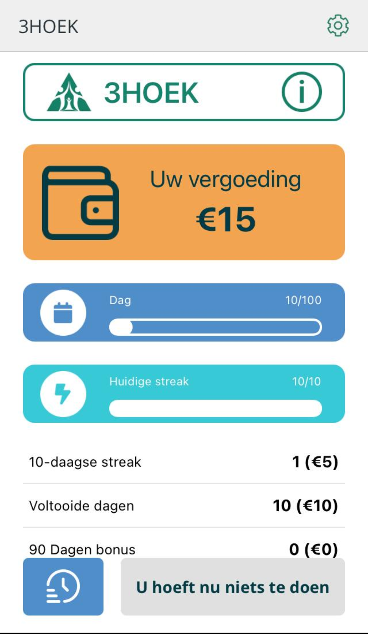
3HOEK app
Development of custom app
Daily questionnaires to be filled in from 20:00 to 02:00. Three notifications, start time set via the “Set Your Schedule” button.
Virtual wallet & incentives
1 euro per questionnaire, with bonus of 5 euros at 10-day streak. And extra bonus of 50 euros for participating 90 days.

Slide 8
Main concepts
Unexpected events
Coping strategies
Alternative questions
Wellbeing
Parenting
Partner dynamics

Slide 9
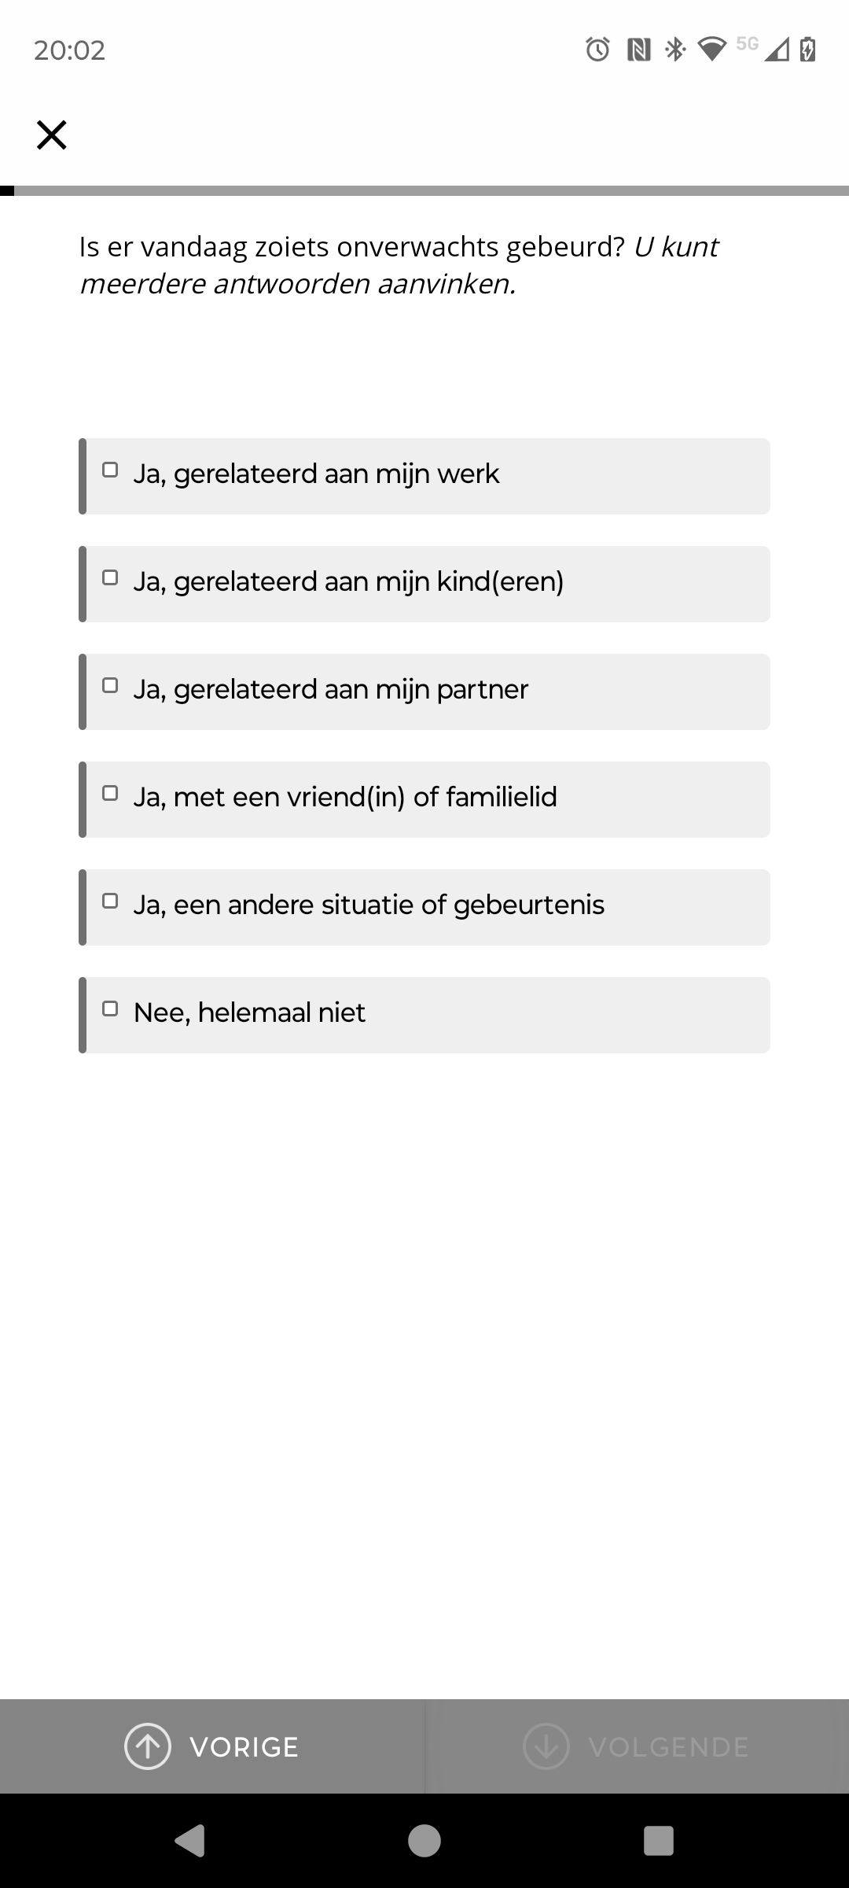
Unexpected events!
Soms verloopt de dag anders dan verwacht. Denk aan een ziek kind, plotseling (over)werken, file, vertraging in het openbaar vervoer, een noodgeval in de familie, of een vriend die hulp nodig heeft. Of gewoon een lastige start van de dag door bijvoorbeeld een lekke band of leeg fietslampje.
---------------------------------------------------------------------------------
Sometimes the day doesn't go as planned. Maybe your child falls ill, you're asked to work late, you get stuck in traffic, public transport is delayed, a family emergency arises, or a friend suddenly needs help. Or simply a difficult start to the day due to, for example, a flat tire or a broken bike light.

Slide 10
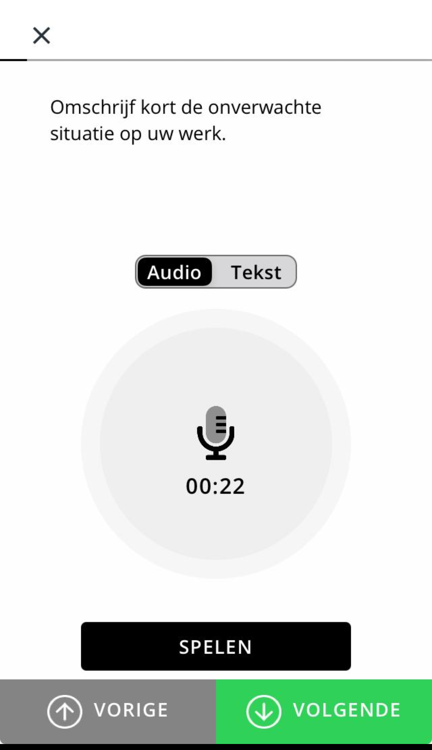
Unexpected events!
Follow-up questions
Could you describe the event?
How stressful was this event?
How unexpected was this event?
Resources & Coping strategies
Problem solving
Support seeking
Avoidance

Slide 11
Response
Finished: June 11th 2025
On average about 225 responses per day

Slide 12
Response
206 people received the 90-day bonus
Finished: June 11th 2025
On average about 225 responses per day

Slide 13
Learning curve
Do
Make participation of both an entry requirement if the goal is to gather dyadic data
Use personal approach in recruitment as well as period of data collection (letters, keychains, daily helpdesk)
Don’t
Assume a customized app has the same functionalities as the basic app (for Avicenna)
Expect to app to work similarly for iOS and Android
Forget that it takes time for new versions of custom apps to be ready and approved (in case of errors during data collection)

Slide 14
Contact
www.driehoekonderzoek.nl
3hoek@essb.eur
06 16 07 13 99
Prof. dr. Renske Keizer
Dr. Maaike Hornstra
Shelby Sissing, MSc
Petra Olsthoorn, MSc

