Slide 1


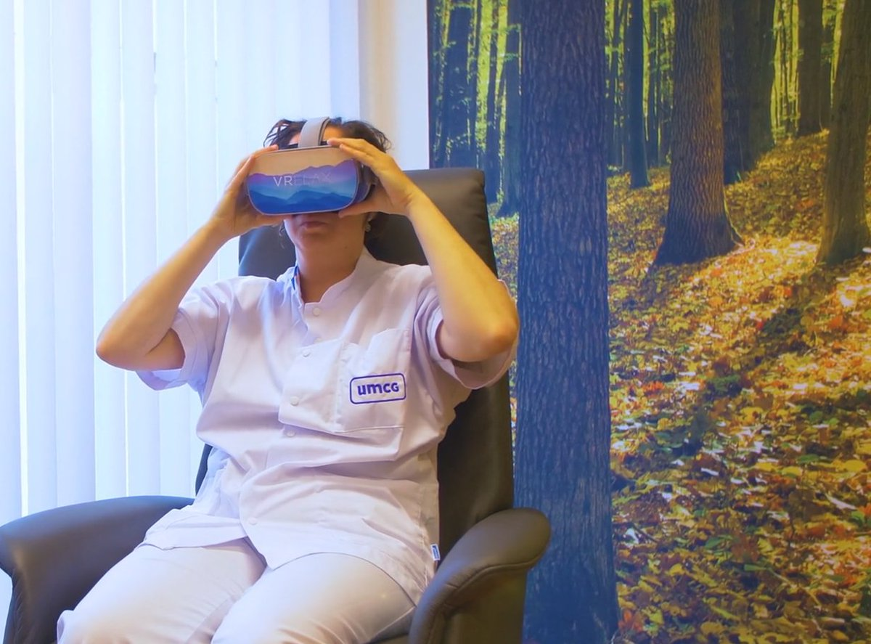

ESM meeting 2025
VR therapy for burnout
A single case experimental design
Marij Zuidersma
esm-network.eu
Notes:
I am a senior researcher working at the UMCG in Groningen and I will talk about our study evaluating VR therapy in employees with burnout

Slide 2

Design
Single case experimental design: AB design
Virtual reality relaxation, daily 15 mins for 3 weeks
N=70 employees with burnout symptoms
Daily outcome: ‘I feel calm’

Slide 3
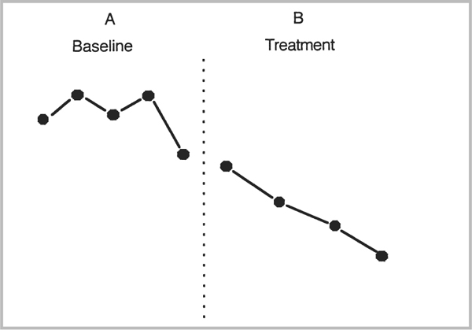
Analysis
For each person separately
Visual analysis: 4 indices^{1,2}
Mean
Trend
Variability
Overlap
Immediacy
Consistency
If visual analysis concludes that treatment is effective → effect size calculation^{3,4}
Example: Standardized mean difference
¹Morley, Stephen. (2015/06/15). Chapter 5: Visual analysis for single case data. In: Single Case Methods in Clinical Psychology, Morley (editor) 2017).
²Ledford, J. R., Lane, J. D., & Severini, K. E. (2018). Systematic use of visual analysis for assessing outcomes in single case design studies. Brain Impairment, 19(1), 4-17.
³Manolov R, Moeyaert M. Recommendations for Choosing Single-Case Data Analytical Techniques. Behav Ther. 2017 Jan;48(1):97-114. doi: 10.1016/j.beth.2016.04.008. ⁴Fingerhut, J., & Moeyaert, M. (2022). Selecting quantitative analysis techniques in single-case research through a user- friendly open-source tool. Frontiers in Education. 7:1064807. doi: 10.3389/feduc.2022.1064807

Slide 4
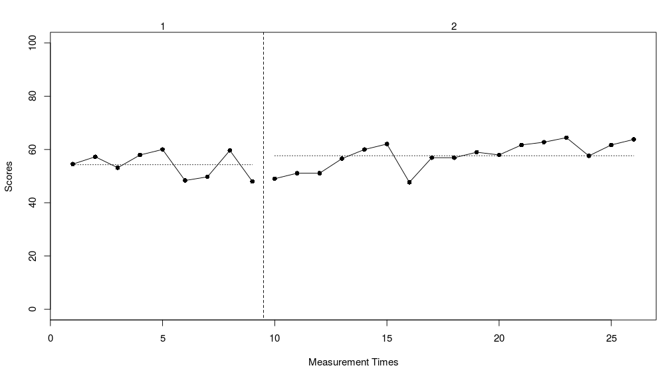
Results: example 1 participant
Difference in mean
Mean baseline: 54.3
Mean intervention: 57.7
Difference in mean: 3.4
Notes:
I will show you the results of 1 participant. We see the plot here for Calm during both phases. The horizontal lines indicate the means for the phases.
There is a small difference in mean level favouring intervention. You can wonder whether this is a relevant difference, but that is something you should have indicated a priori of course.

Slide 5
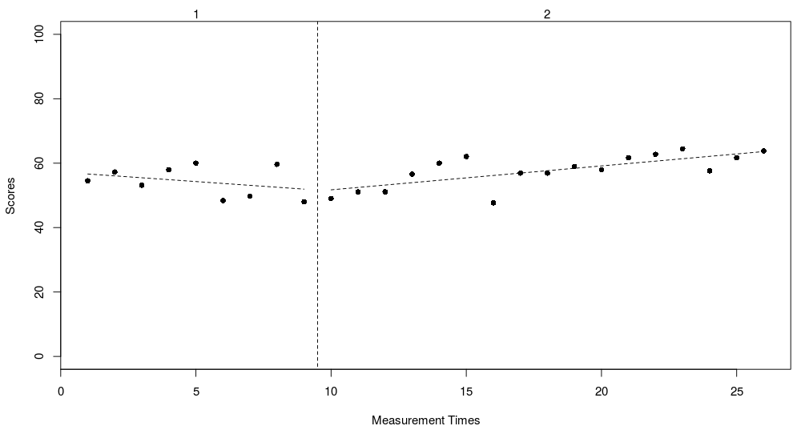
Results: example 1 participant
Difference in trend
Trend baseline: -0.59
Trend intervention: 0.74
Diff trend: 1.33
Notes:
Also, the difference in trend indicates a positive effect for the intervention. You see the trend going down during the baseline phase and going up during the intervention phase. Again, whether this difference is relevant, is up to the decision of the researcher, and a cut-off should be set a priori.

Slide 6
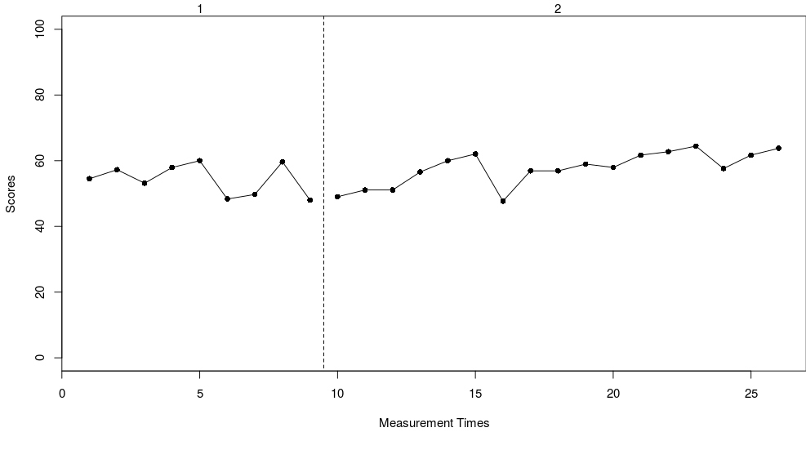
Results: example 1 participant
Variability:
Lines at median +/-25% at each phase
80% of points should fall within these lines
Even 100% fall within lines → variability = low enough
Notes:
Then, we look at variability of the datapoints. If variability is too high, then we cannot reliably interpret the previous indices of mean and trend. For this purpose, we draw horizontal lines at the median +/- 25% and 80% of datapoints should fall within these lines. For this person, 100% of datapoints fall within these lines, so variability is relatively low, supporting reliability of the other indices

Slide 7
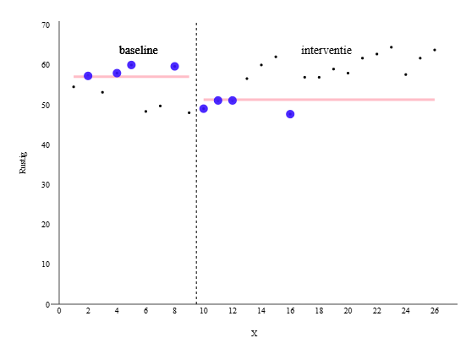
Results: example 1 participant
Overlap (improvement Rate Difference)¹
IR baseline = 4/9 = 0.44
IR intervention = 13/17 = 0.76
IRD: 0.76 – 0.44 = 0.32 (favors intervention, but below 0.5=too small)
¹Parker, Vannest & Brown, (2009) Exceptional Children Vol. 75, No. 2, pp. 135-150.
Notes:
Another measure that is important to look at is overlap. So, the number of overlapping points between baseline and intervention. The less the overlap, the more likely the intervention worked. There are many measures for overlap, but we used the IRD.
In this participant the IRD is positive, showing a favour of the intervention, but it is lower than 0.5, which is the threshold the authors have set for the IRD to conclude the intervention is effective.

Slide 8
In summary
Visual analysis:
3 out of 4 indicators suggest the intervention to work
Effect size: Standardized mean difference
(mean(A) – mean(B))/SD(A)
0.71 --> medium effect (according to Cohen’s benchmark)
Intervention is effective with small/medium effect

Slide 9





Our Team
Catheleine van Driel
Matthijs Nijland
Wim Veling
Marij Zuidersma
UMCG
UMCG
UMCG
UMCG

Slide 10
ESM meeting 2025
THANK YOU
esm-network.eu
m.zuidersma@umcg.nl
Shiny apps used:
https://architecta.shinyapps.io/Paraplu/ (Samantha Bouwmeester)¹
https://tamalkd.shinyapps.io/scda/ (Rumen Manolov)²
¹Bouwmeester S, Jongerling J. Power of a randomization test in a single case multiple baseline AB design. PLoS One. 2020 Feb 6;15(2):e0228355.
² Tamal Kumar De, Bart Michiels, Johan W.S. Vlaeyen, and Patrick Onghena: One by One: A Shiny Web-app for the Design and Analysis of Single-Case Experiments

